Slide 1
FYPJ Final Presentation
By Vignesh, Lester & Bryan

Slide 2
Project Background
NYP conducts various events around the year
Currently, booking seats for these events uses physical tickets that must be printed, cut and then given out to the attendees when they arrive
Possible consequences of this process
Wastage of large amounts of paper
Confusion during the printing process
Inefficient allocation of manpower due to time wasted on cutting and printing
Notes:
virtualises

Slide 3
Proposed Solution
Virtualize the ticketing process for events conducted in NYP
An online system for students and teachers to access and aid in the management and on-site reservation of events
Functionalities
Creating and updating venues, each of which should have a customized seat map
Assigning events to each venue and updating them
Reserve seats for event attendees by either using an algorithm or manual selection
Create accounts with specified roles that take care of event creation and seat reservation respectively

Slide 4
Biggest Changes
Allowing auto-assignment of seats for reservation using a robust algorithm
Searching accounts, venues and seat reservations
Seat map enhancements, including
Allowing for real-time changes to the map
Shift-clicking seat map
Seat map zooming
Made everything in the application dynamic and persistent, including
Creation and updating of venues and events
Creation and deleting of seat reservations
Adding and deleting of waiting list entries
Various types of validation
Various UI improvements, including allowing the entire app to be mobile-friendly

Slide 5
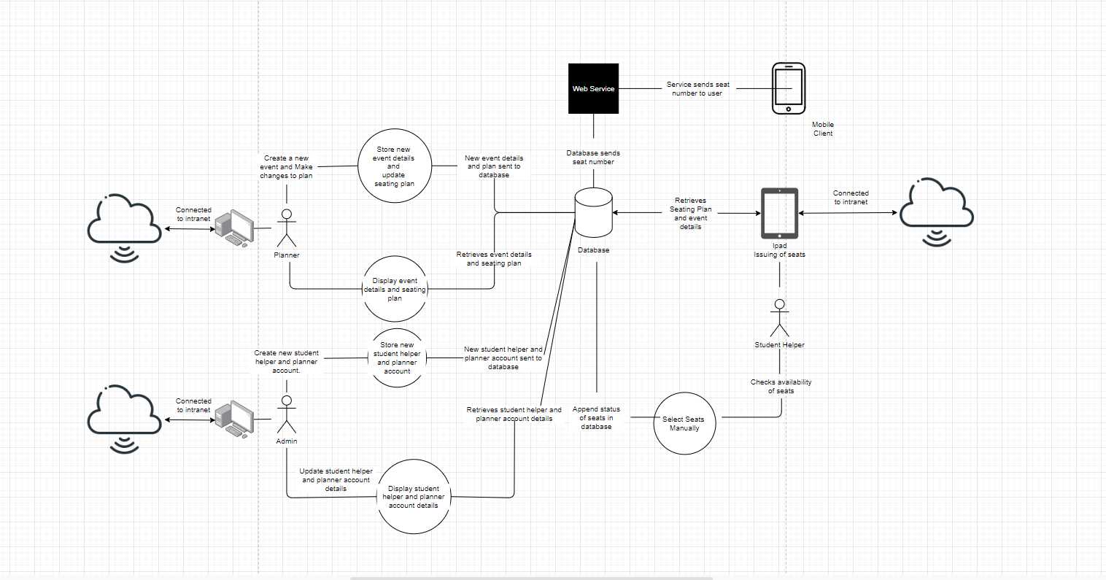
System Diagram

Slide 6
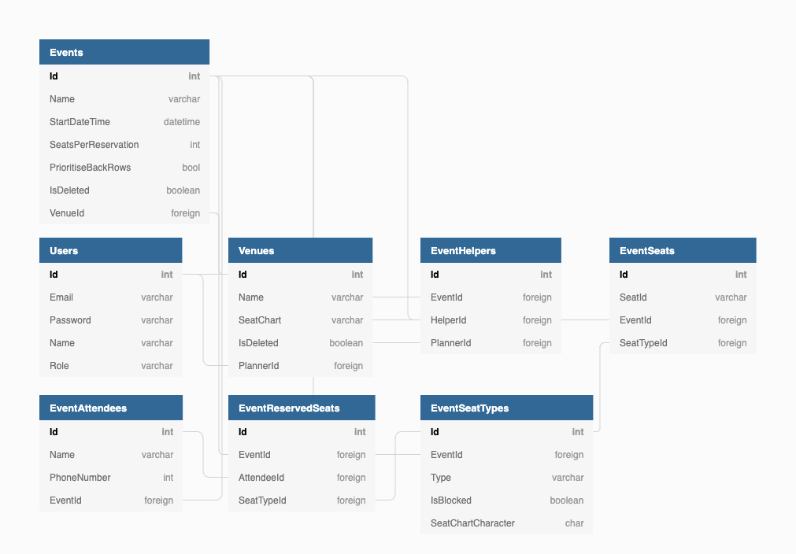
Schema Diagram

Slide 7
Work/Feature Allocation
Vignesh
Planner Features (Event Creation)
Restructuring of the system
Creation of Venues
Lester
Administrator – Creation of Planner and Helper Accounts
Validations
SMS
Waiting List
Restructuring of the system
Bryan
Reservation of Seats (Helper)
Helper’s Seat Charting System

Slide 8
Demo
Notes:
So

Slide 9
Initial Plan From Week 1 - 6
Come out with a prototype for the system
Finalize system structure and database design
Complete database implementation and finalize front end design
Partial integration of both front-end and back-end

Slide 10
Work Done From Week 1 -3
For us the first 3 weeks on the project was working from home, so this is what we did:
We were tasked to come out with a prototype individually meaning there was 3 prototype, based on the previous batch’s documentation and codes.
By looking at the previous batch’s documentation and codes, we were able to understand the project much more clearly too.
From there, we were able to have a rough idea on what we wanted the final design to look like and draft our prototype accordingly
After producing the prototype, we went through different iterations each week to improve on our design and we finally settled on Vignesh's UI as it was the most visually appealing.

Slide 11
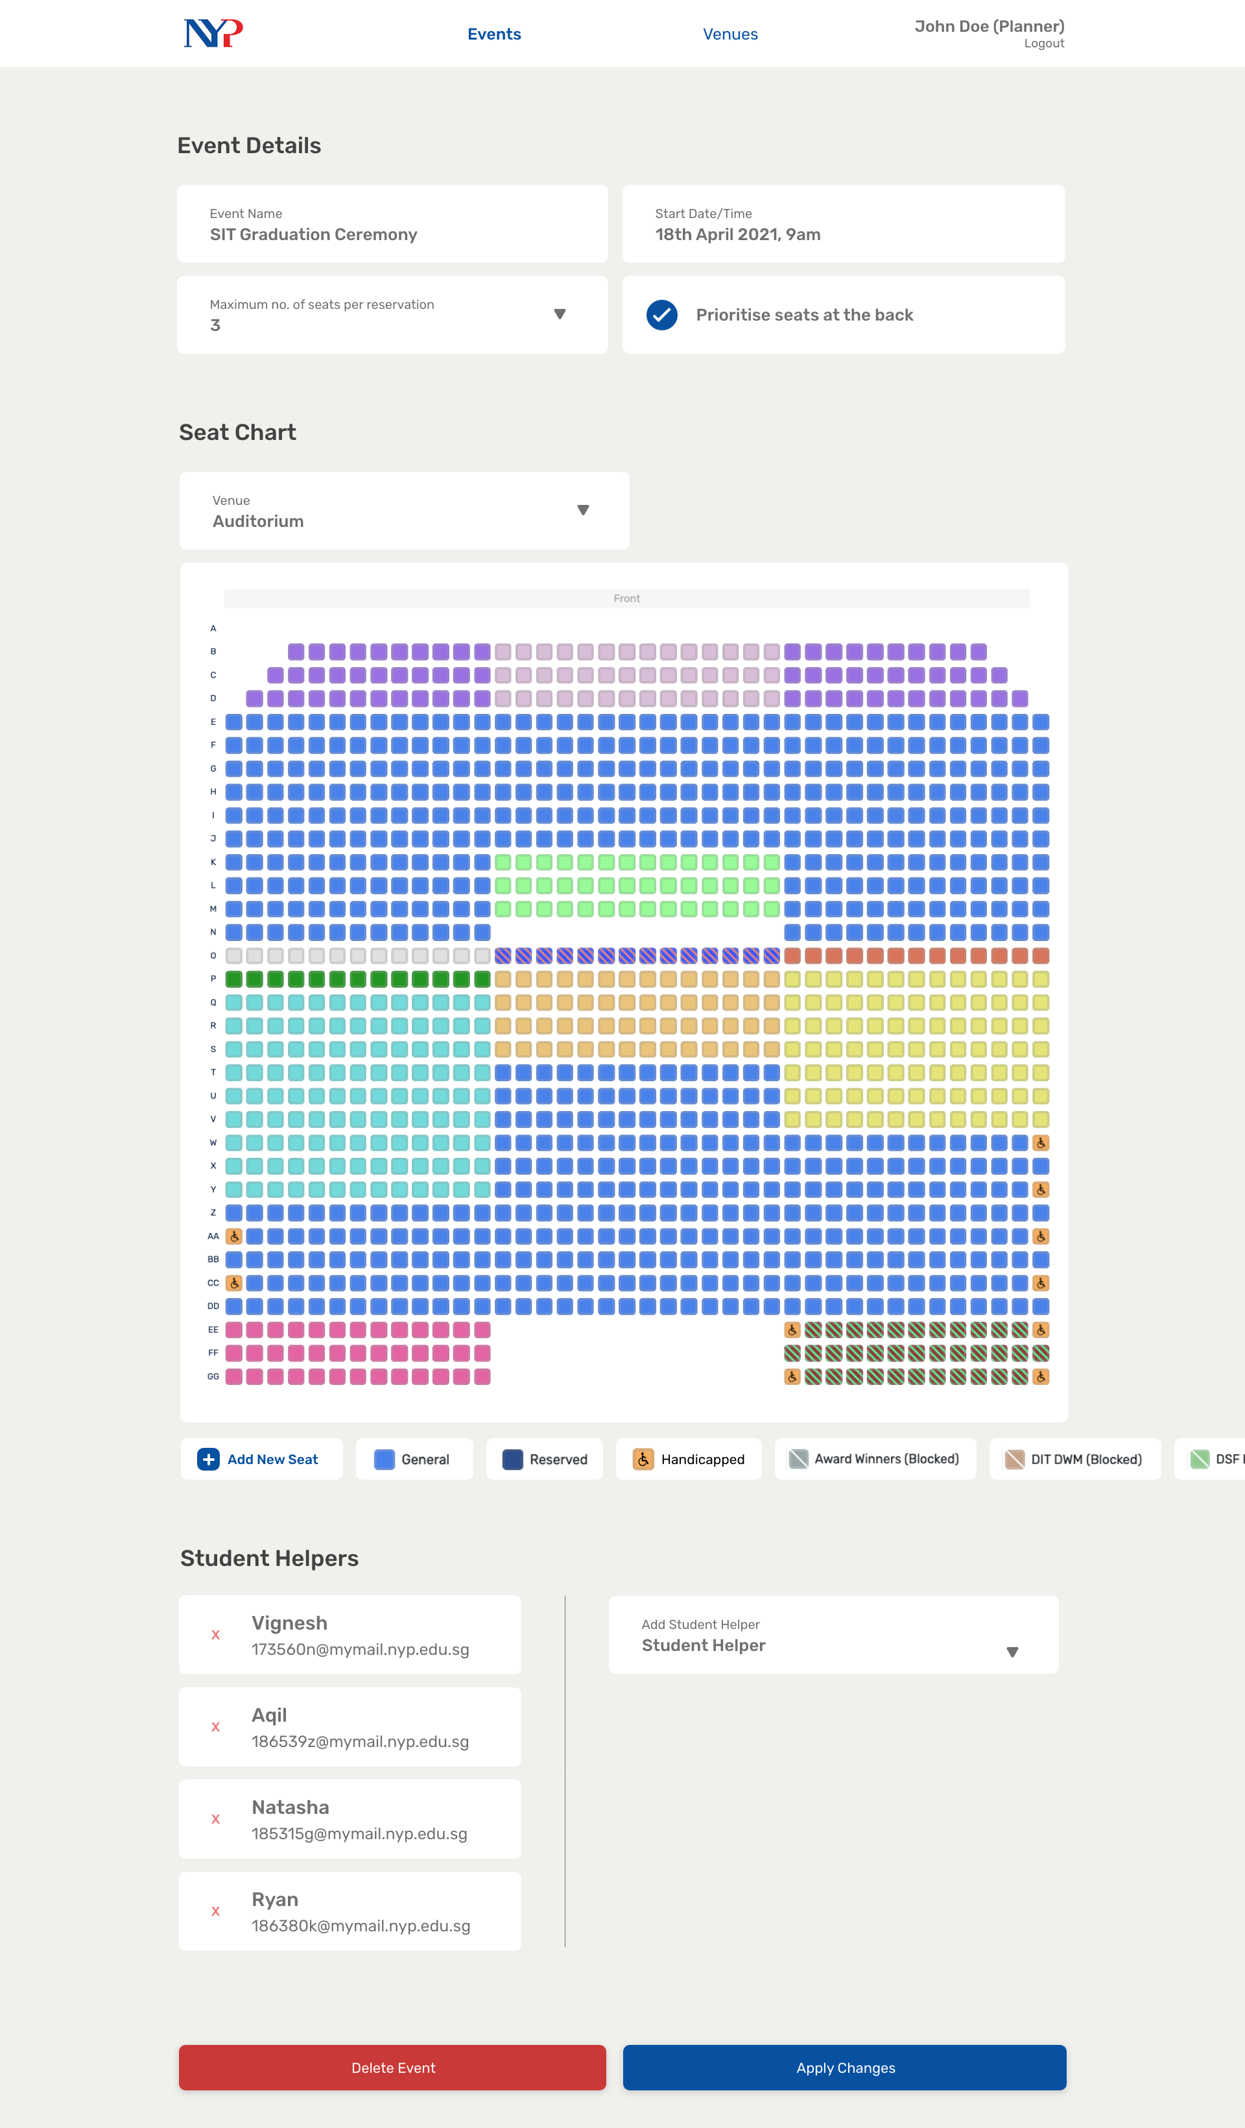
Notes:
45

Slide 12
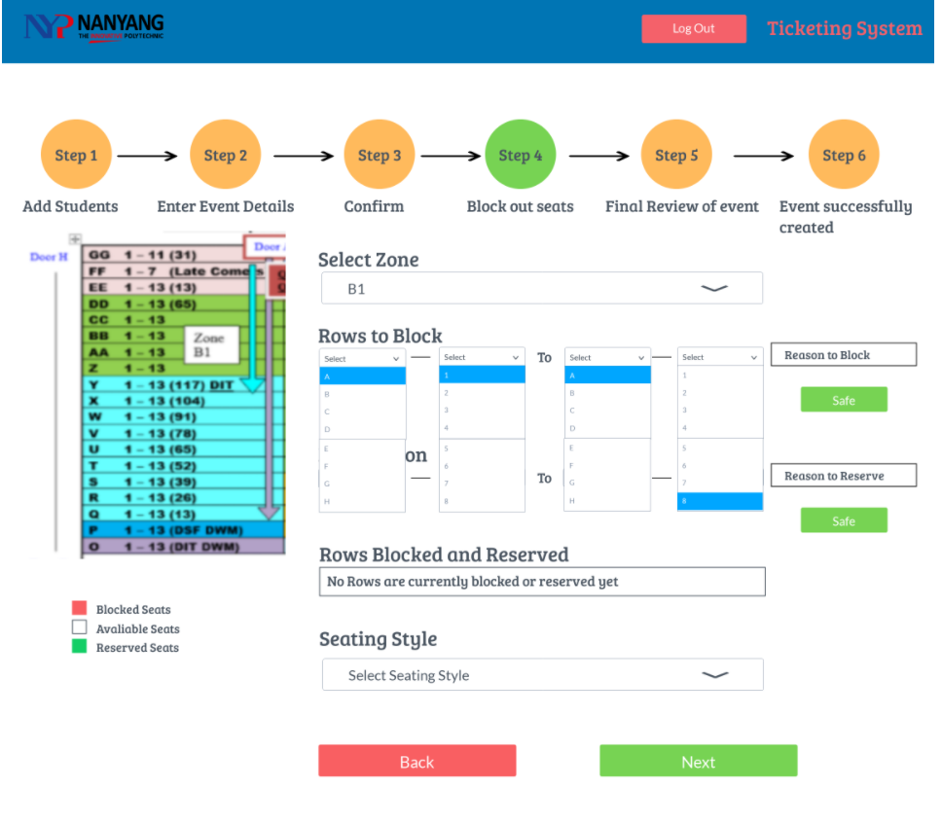
Notes:
45

Slide 13
Work Done from Week 3 - 6
Administrators
Create and Delete Helper & Planner Accounts
Planners
Add Events, which in turn should have the following details
Add and Delete Venues, which should have an accurate seat chart
Helpers
View Events and Event Details

Slide 14
Work Plan for Week 6 - 12
In the next 6 weeks, the app should include the following features:
Allow Administrators
Think of a way to allow admin to sort the list of planner/helper accounts by name, email
Or instead show the date of created so the admin is able to see clearer of how the table is group by
Another way is to add pagination
Allow Planner
Edit and Delete Events, which in turn should have the following details
Allow Helpers
Reserve seats in event
Search for existing reservations
Delete reservations
Put guests in waiting list if they exceed the mandated amount of seats per reservations
SMS Attendee their Seat Numbers
Hosting of the system

Slide 15
Challenges
Vignesh
Creation of the seating chart system, as I had to figure out a feasible method for us to integrate a flexible mapping system
Figuring out how to integrate the back end into the various features we have
Lester
Adapting to and understanding of the new programing language which is, NodeJS and JavaScript, as I am not very experienced with it, compared to C#/Asp.net which I have more experience in.
Bryan
Similarly to what Lester has mentioned, due to a lack of experience in developing in Javascript, it was really difficult to understand all the new and different syntax and functions of the language itself. Additionally, I struggled during the implementation of the database since I am using an IDE that I have very little exposure to.

Slide 16
Overcoming these Challenges
Vignesh
In the end, I settled on using seat plugin as a base and then experimenting with it to find ways to customize the mapping system to fit the application needs
As for the back end, using a database wrapper made integration relatively painless
Lester
As, I was relatively new to the programming language, JavaScript, what I did to overcome these challenges was to look up tutorial videos online and create a simple TODO list application. Furthermore, I also seek help from Vignesh who is much more experienced in the programming language.
Bryan
Likewise, being new JavaScript I had to constantly search for tutorials online and also refer to different communities such as (Reddit and Stack Overflow) for resources to aid in the understanding of the new language. My teammates were also really helpful during the learning process as they patiently sat down with me to help me understand the various blocks of codes in our project

Slide 17
Thank you!

Slide 18
Job Scope
App should be able to
Allow Administrators
Create and Delete Helper & Planner Accounts
Allow Planners
Add, Edit and Delete Events, which in turn should have the following details
Name
Start Date Time
Venue
Maximum number of seats per reservation
Whether they should prioritize back rows
Different seat types
Blocked seats
Helpers assigned
Add and Delete Venues, which should have an accurate seat chart

Slide 19
Job Scope
App should be able to
Allow Helpers
View events
Reserve seats in event
Search for existing reservations
Delete reservations
Put guests in waiting list if they exceed the mandated amount of seats per reservations
SMS Attendee their Seat Numbers

Slide 20
Job Distribution
Vignesh
Planner Features (Venue and Event Creation)
Lester
Administrator
All Role’s Dashboard
Bryan
Authorization & Validation
Reservation of Seats (Helper)
Helper’s Seat Charting System

Slide 21
Job Distribution
For the job distribution, we have decided to split it by the 3 roles, Admin, Planner and Student Helper
However, we have also agreed on helping one another, if any of us needs helps.
This implies that we might not only do the features tied to the role we oversee; we might do other features tied to other roles.

Slide 22
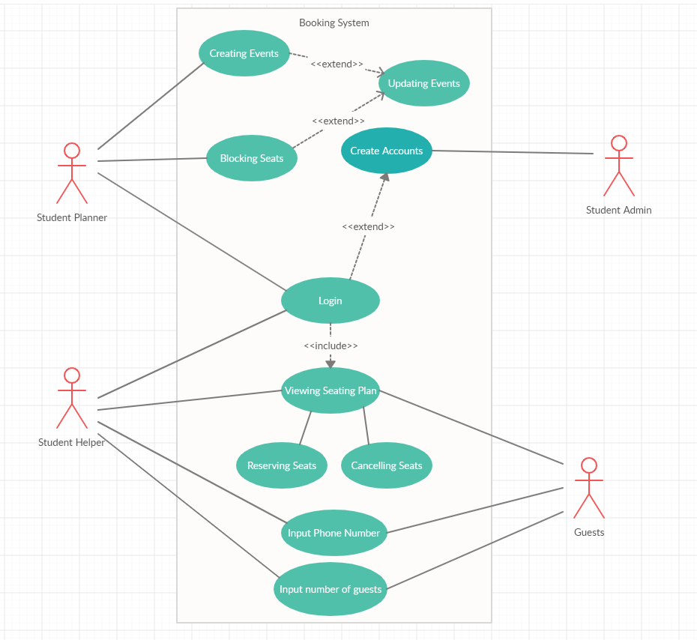
Use Case Diagram

Slide 23
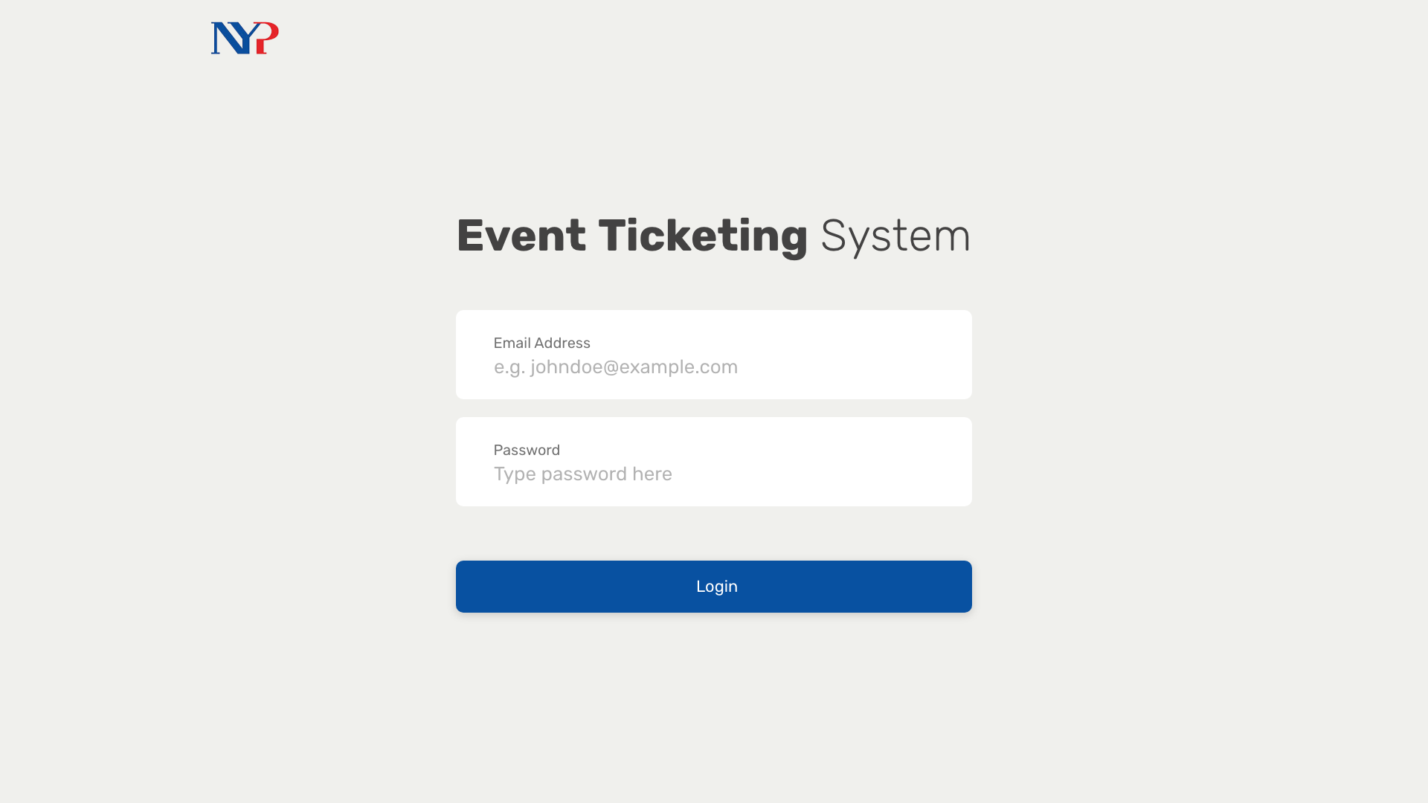
Notes:
We start with the login screen (nothing remarkable)
We might not even have a login screen depending on whether Oauth might work for our project
Anyway, a student will now login to the system.

Slide 24
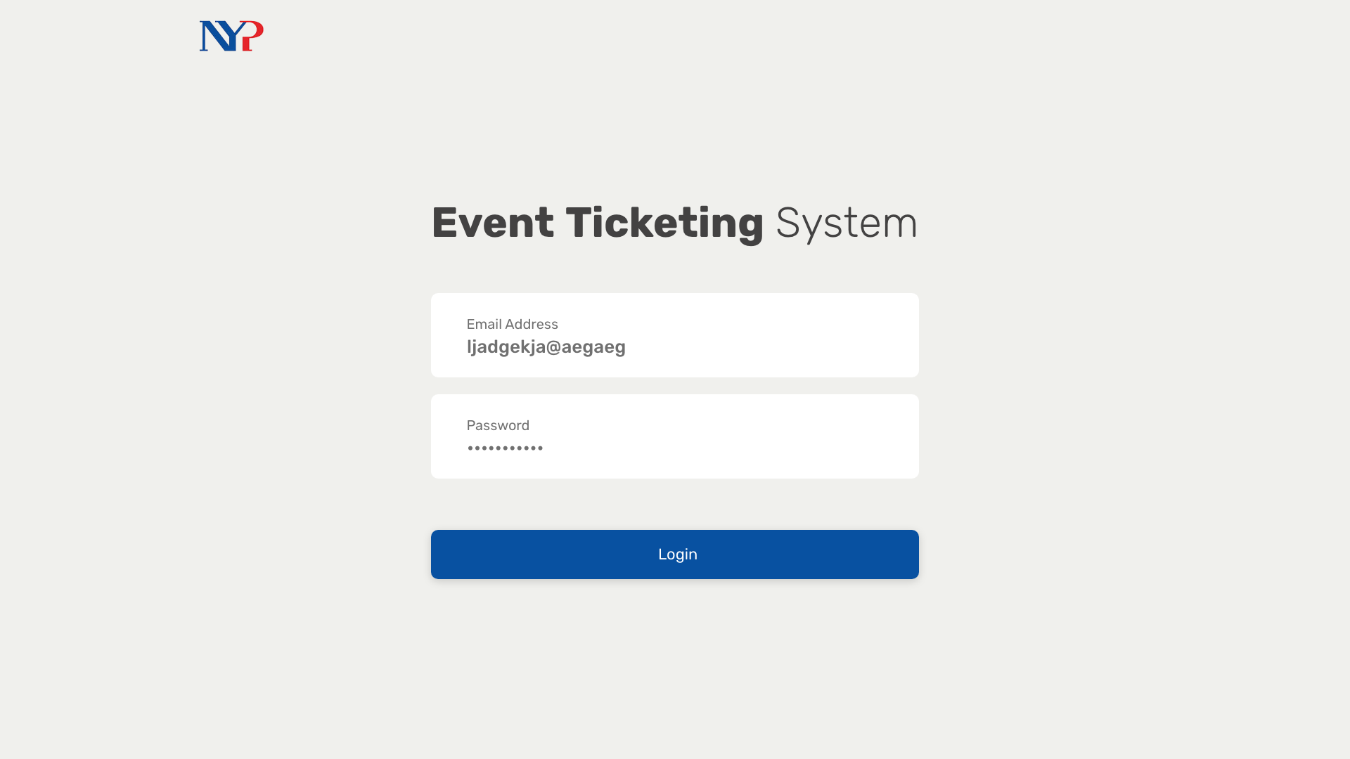
Notes:
Upon entering, they’re presented with this screen where they can view events they are helping with in a more visually appealing manner.
Once they click on one of these event cards, they can view more details.

Slide 25
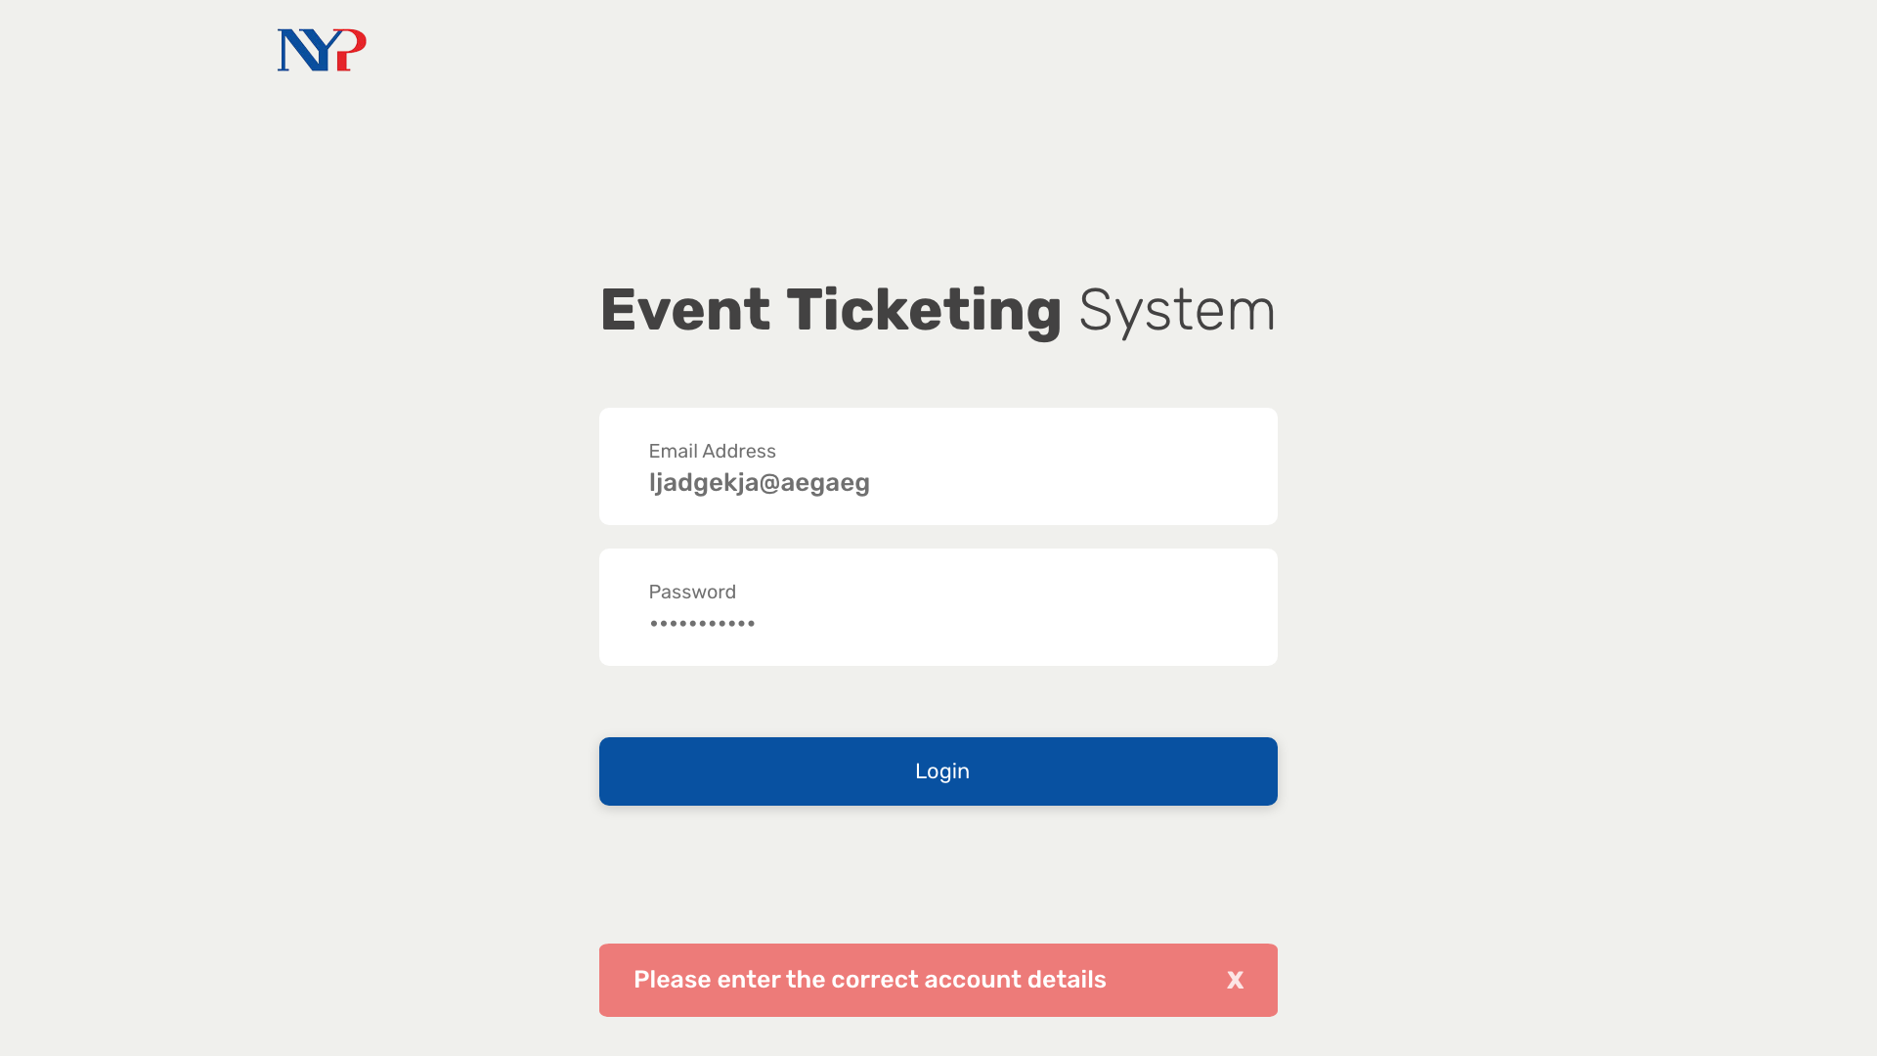
Notes:
So here, they can see the seats that are already reserved in a table form.
They can then choose to reserve a new set of seats by pressing the button.

Slide 26
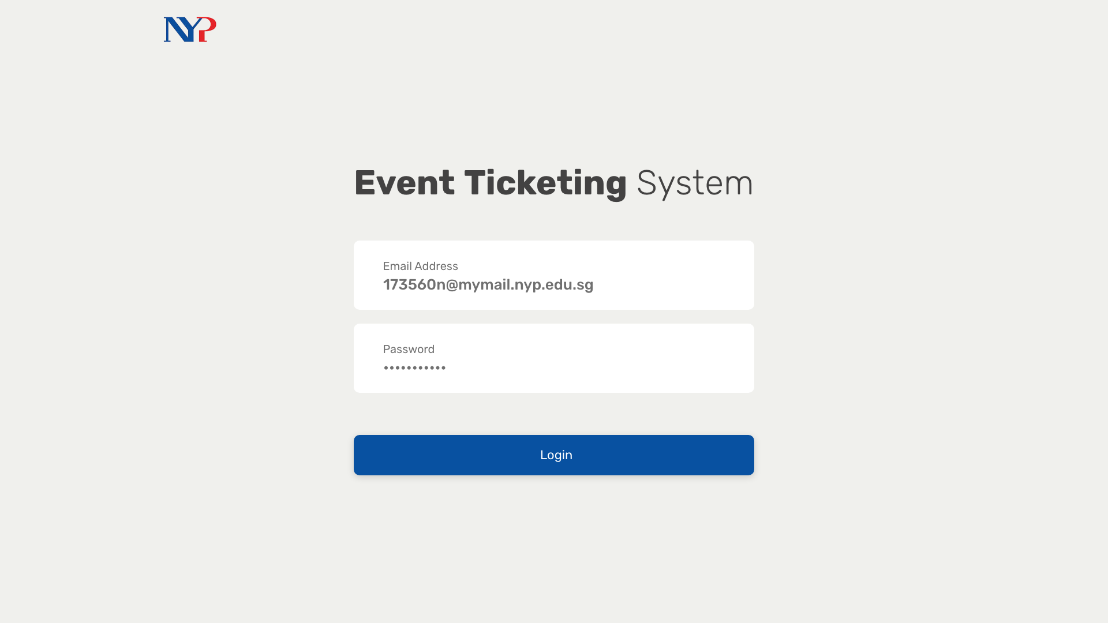
Notes:
over here, i'm using a functional seat chart to show the student helper all the seats that are available in a more visual manner. they can then select the seats they deem fit for the attendees.
after doing so they just have to enter the contact details to send them their tickets via SMS
warn student helper when not booking seats according to criteria (top -> down)
block seats at event creation
able to change handicapped seats for each event
add more validation

Slide 27
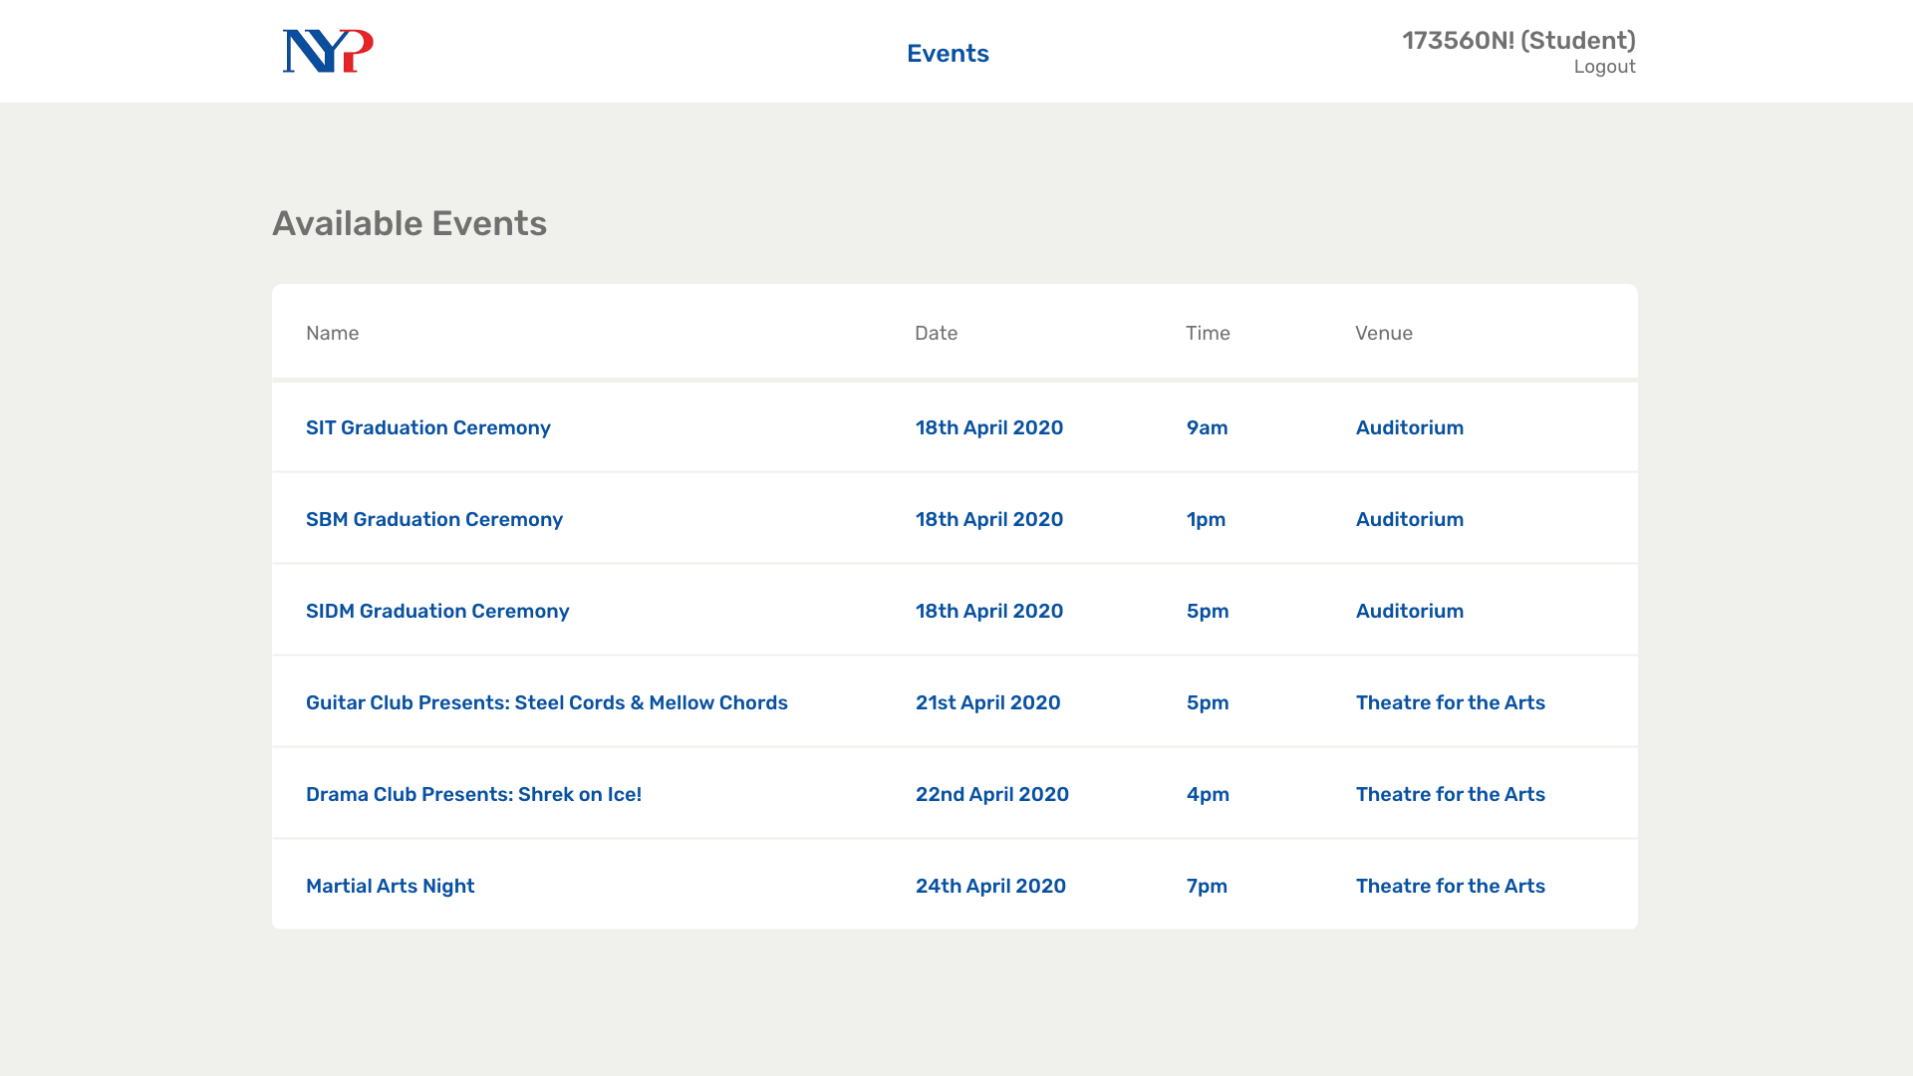
1
Notes:
And after this process is done, they

Slide 28
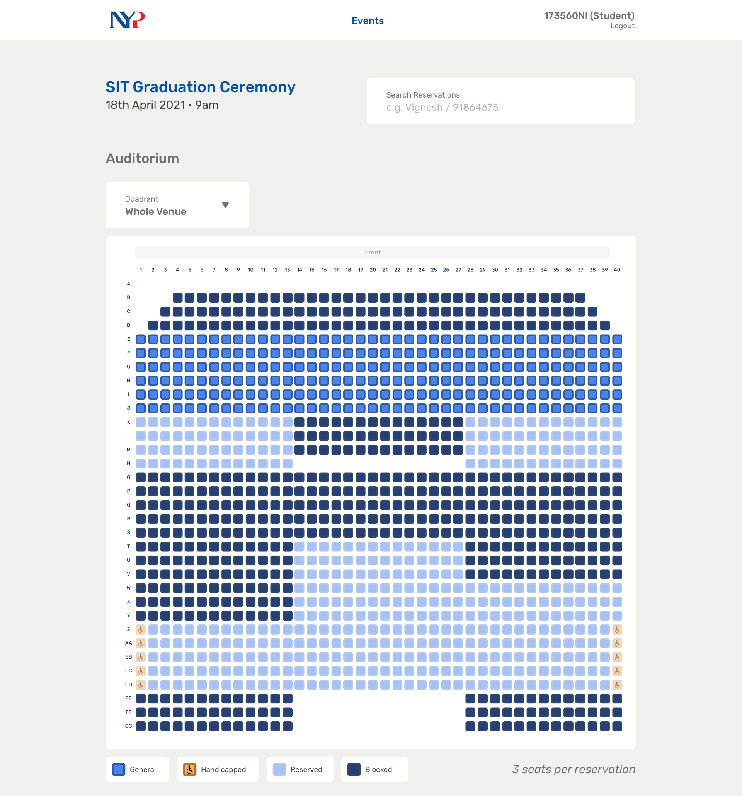

Slide 29
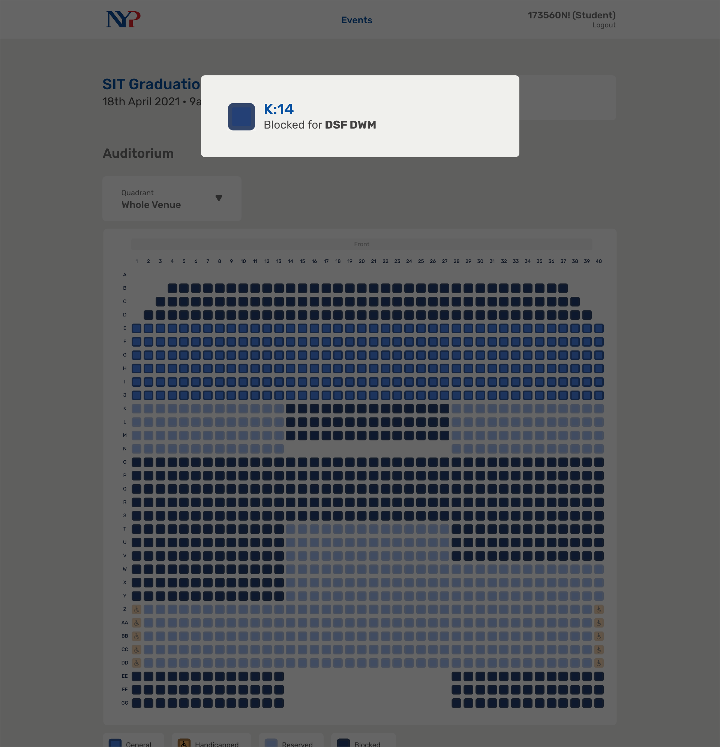
Notes:
7

Slide 30
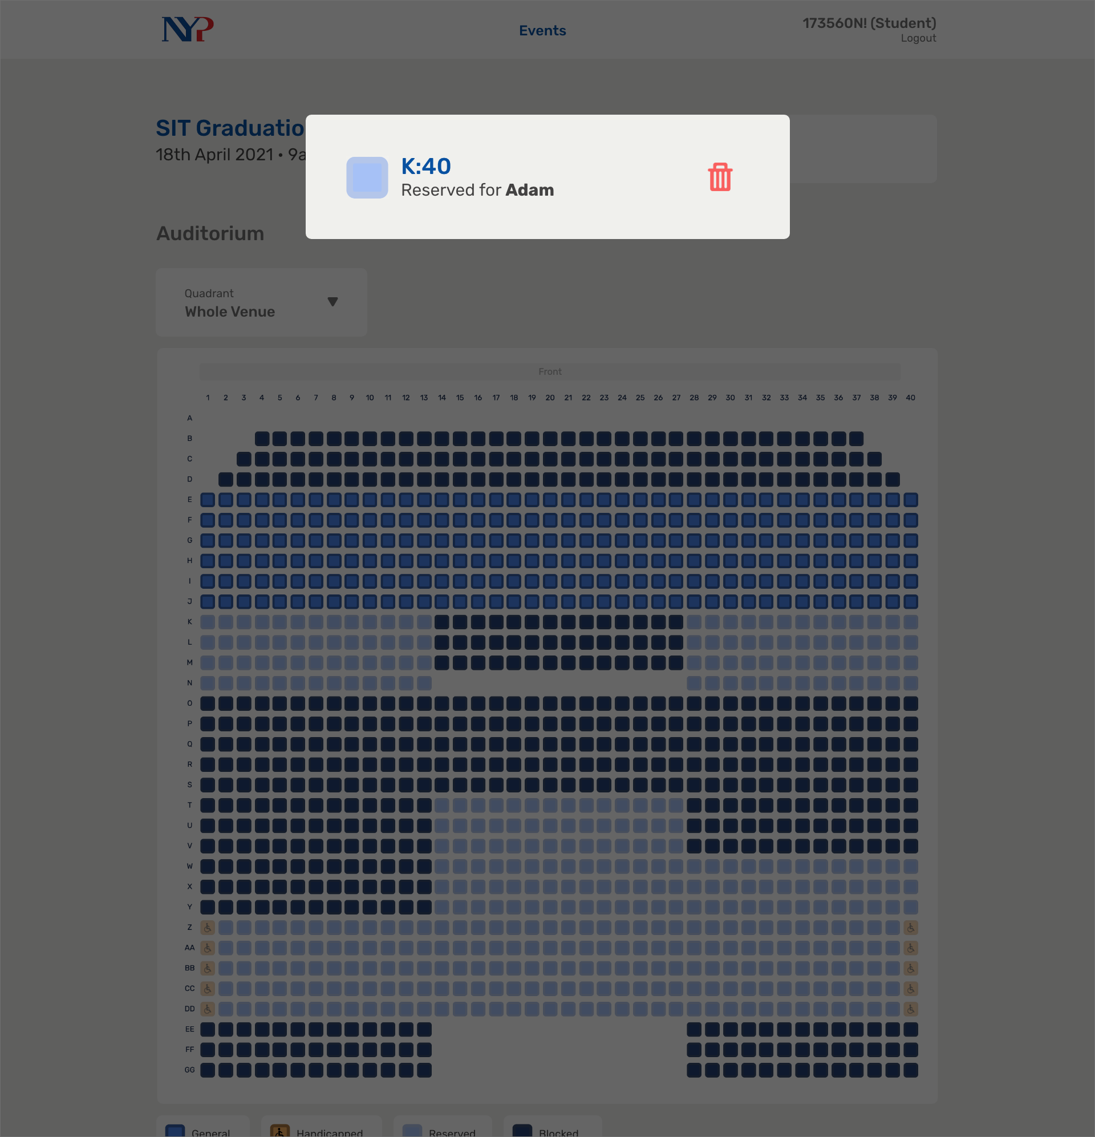
Notes:
8

Slide 31
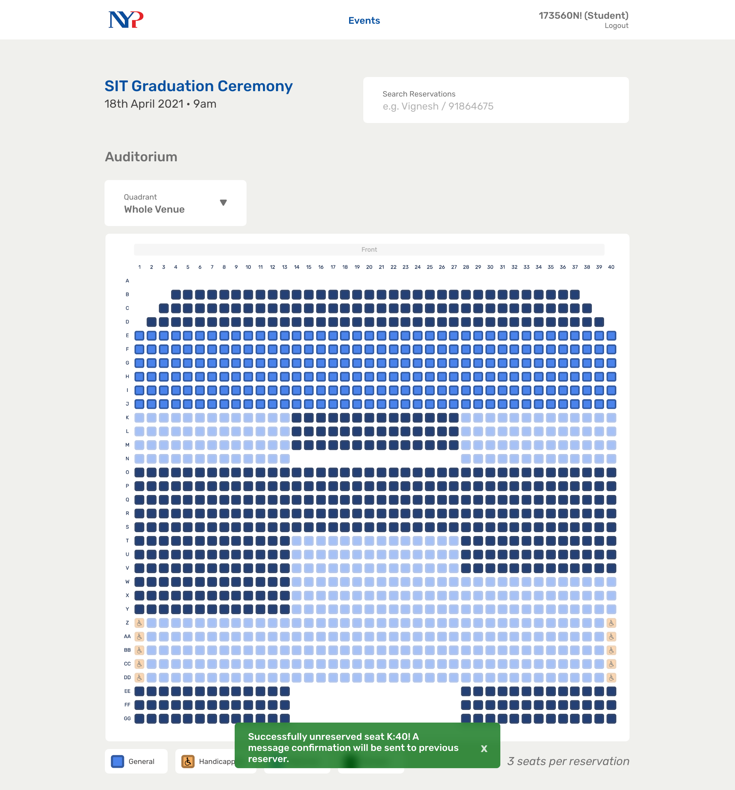
Notes:
9

Slide 32
Notes:
29

Slide 33
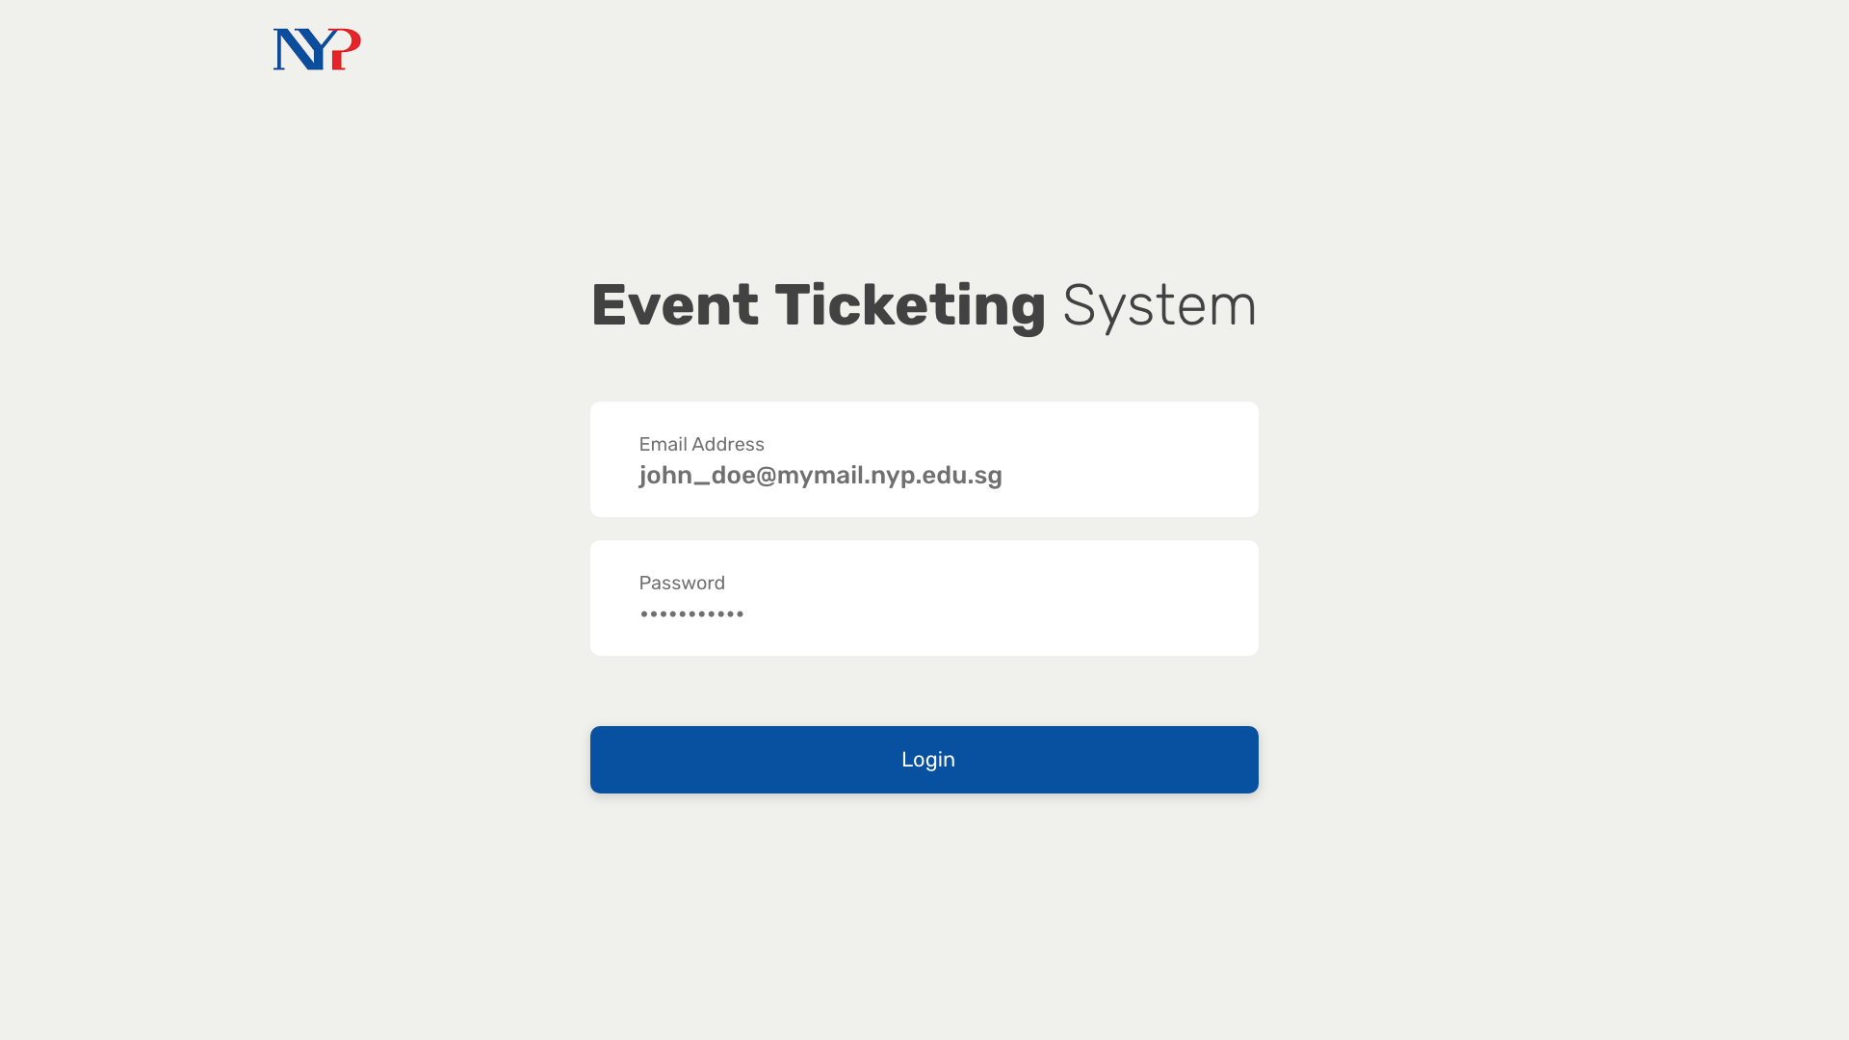
Notes:
30 Planner

Slide 34
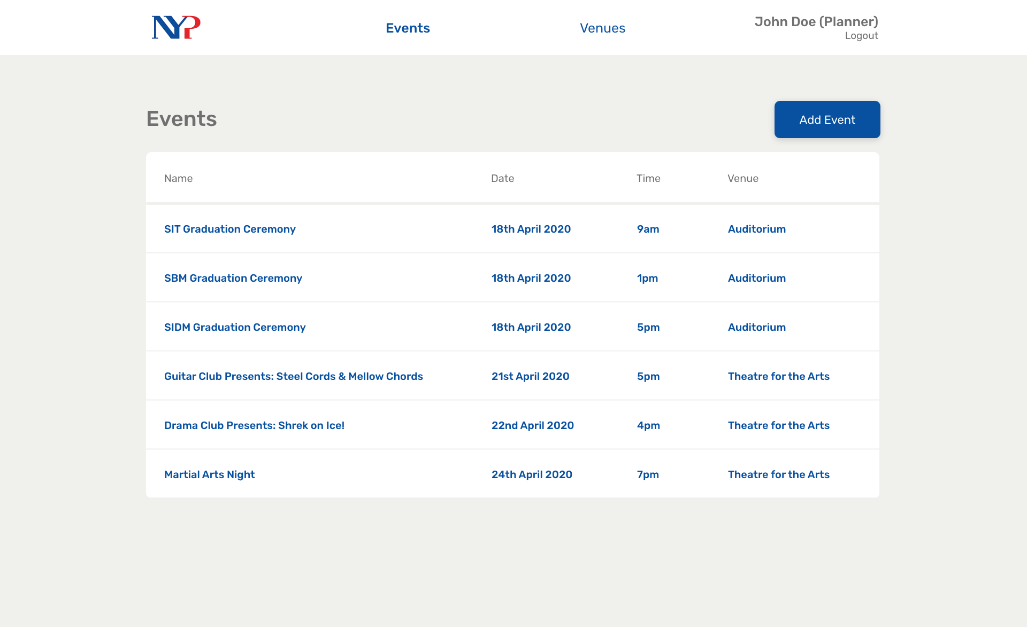
Notes:
31

Slide 35
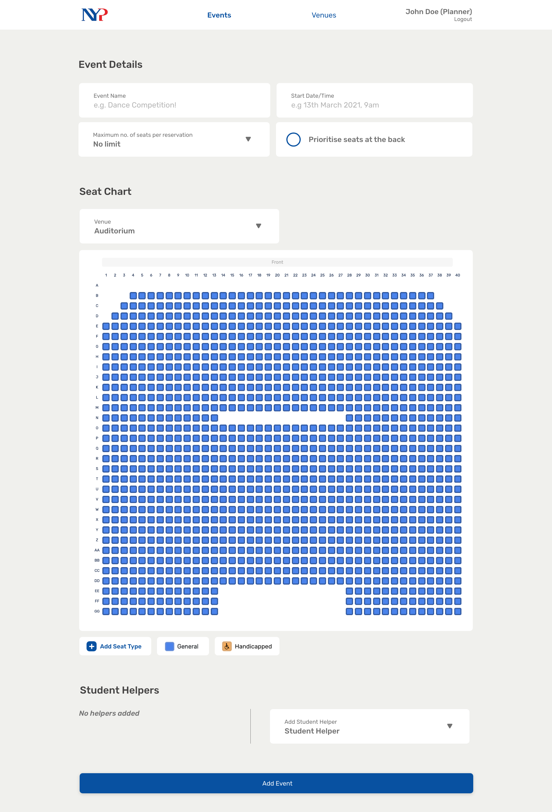
Notes:
32

Slide 36
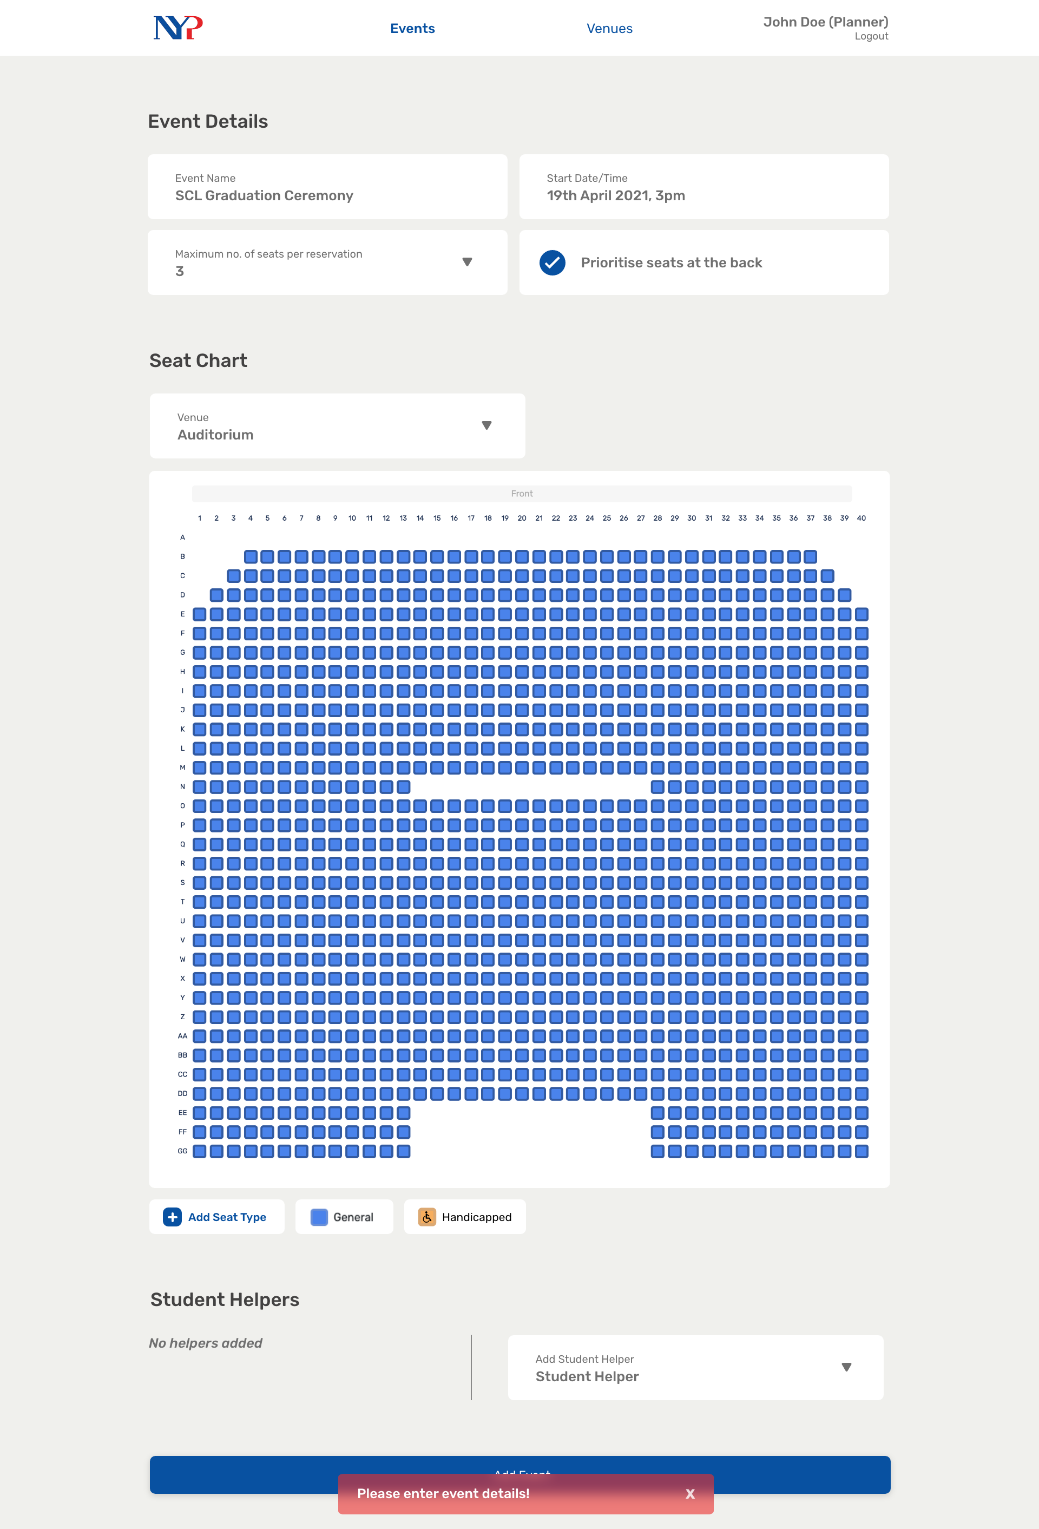
Notes:
33

Slide 37
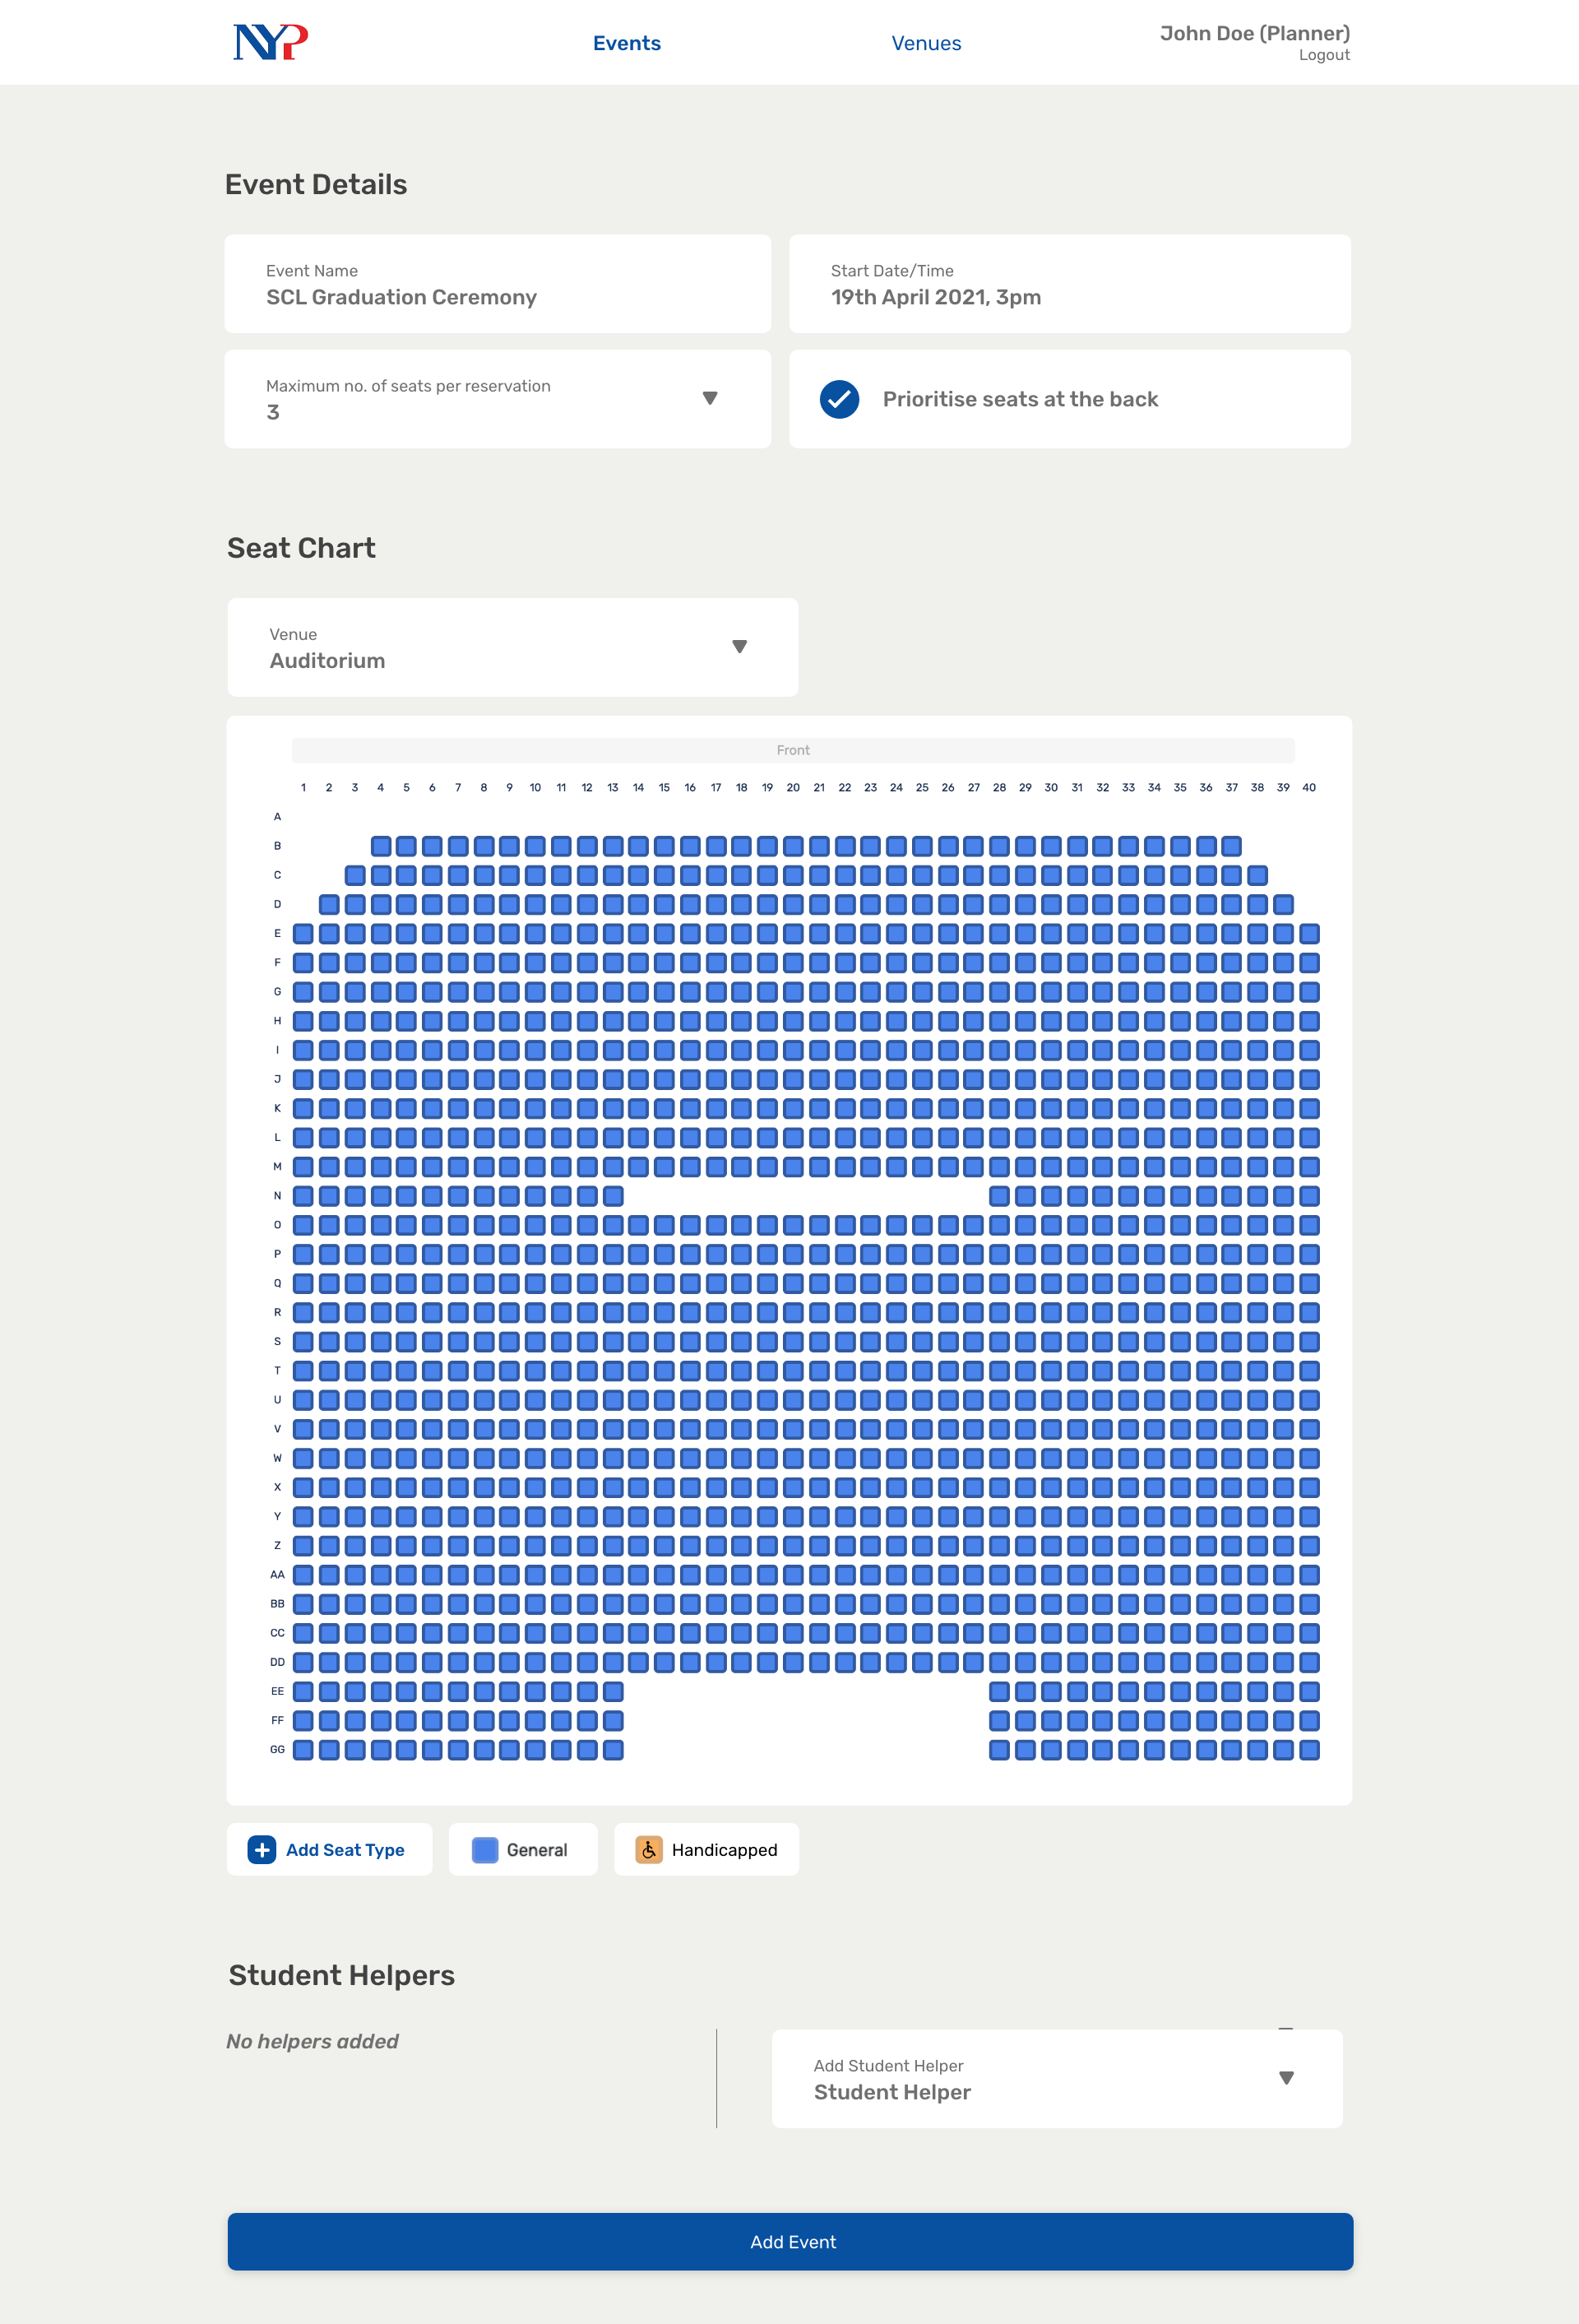
Notes:
34

Slide 38
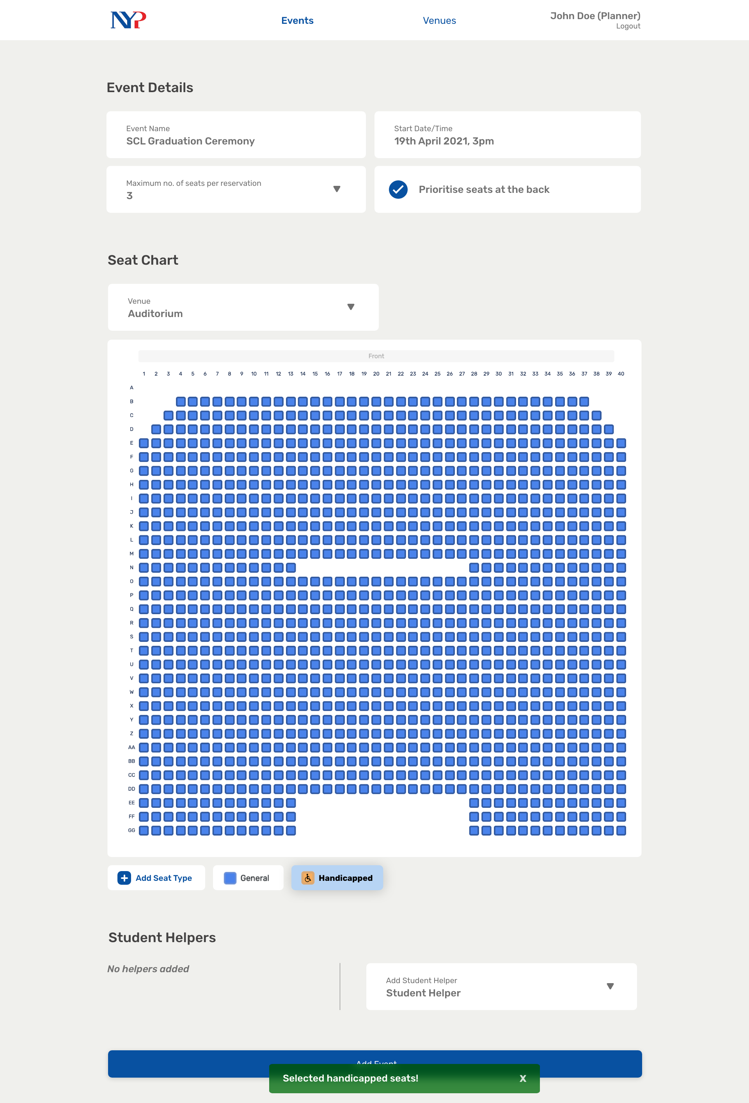
Notes:
35

Slide 39

Notes:
35.5

Slide 40
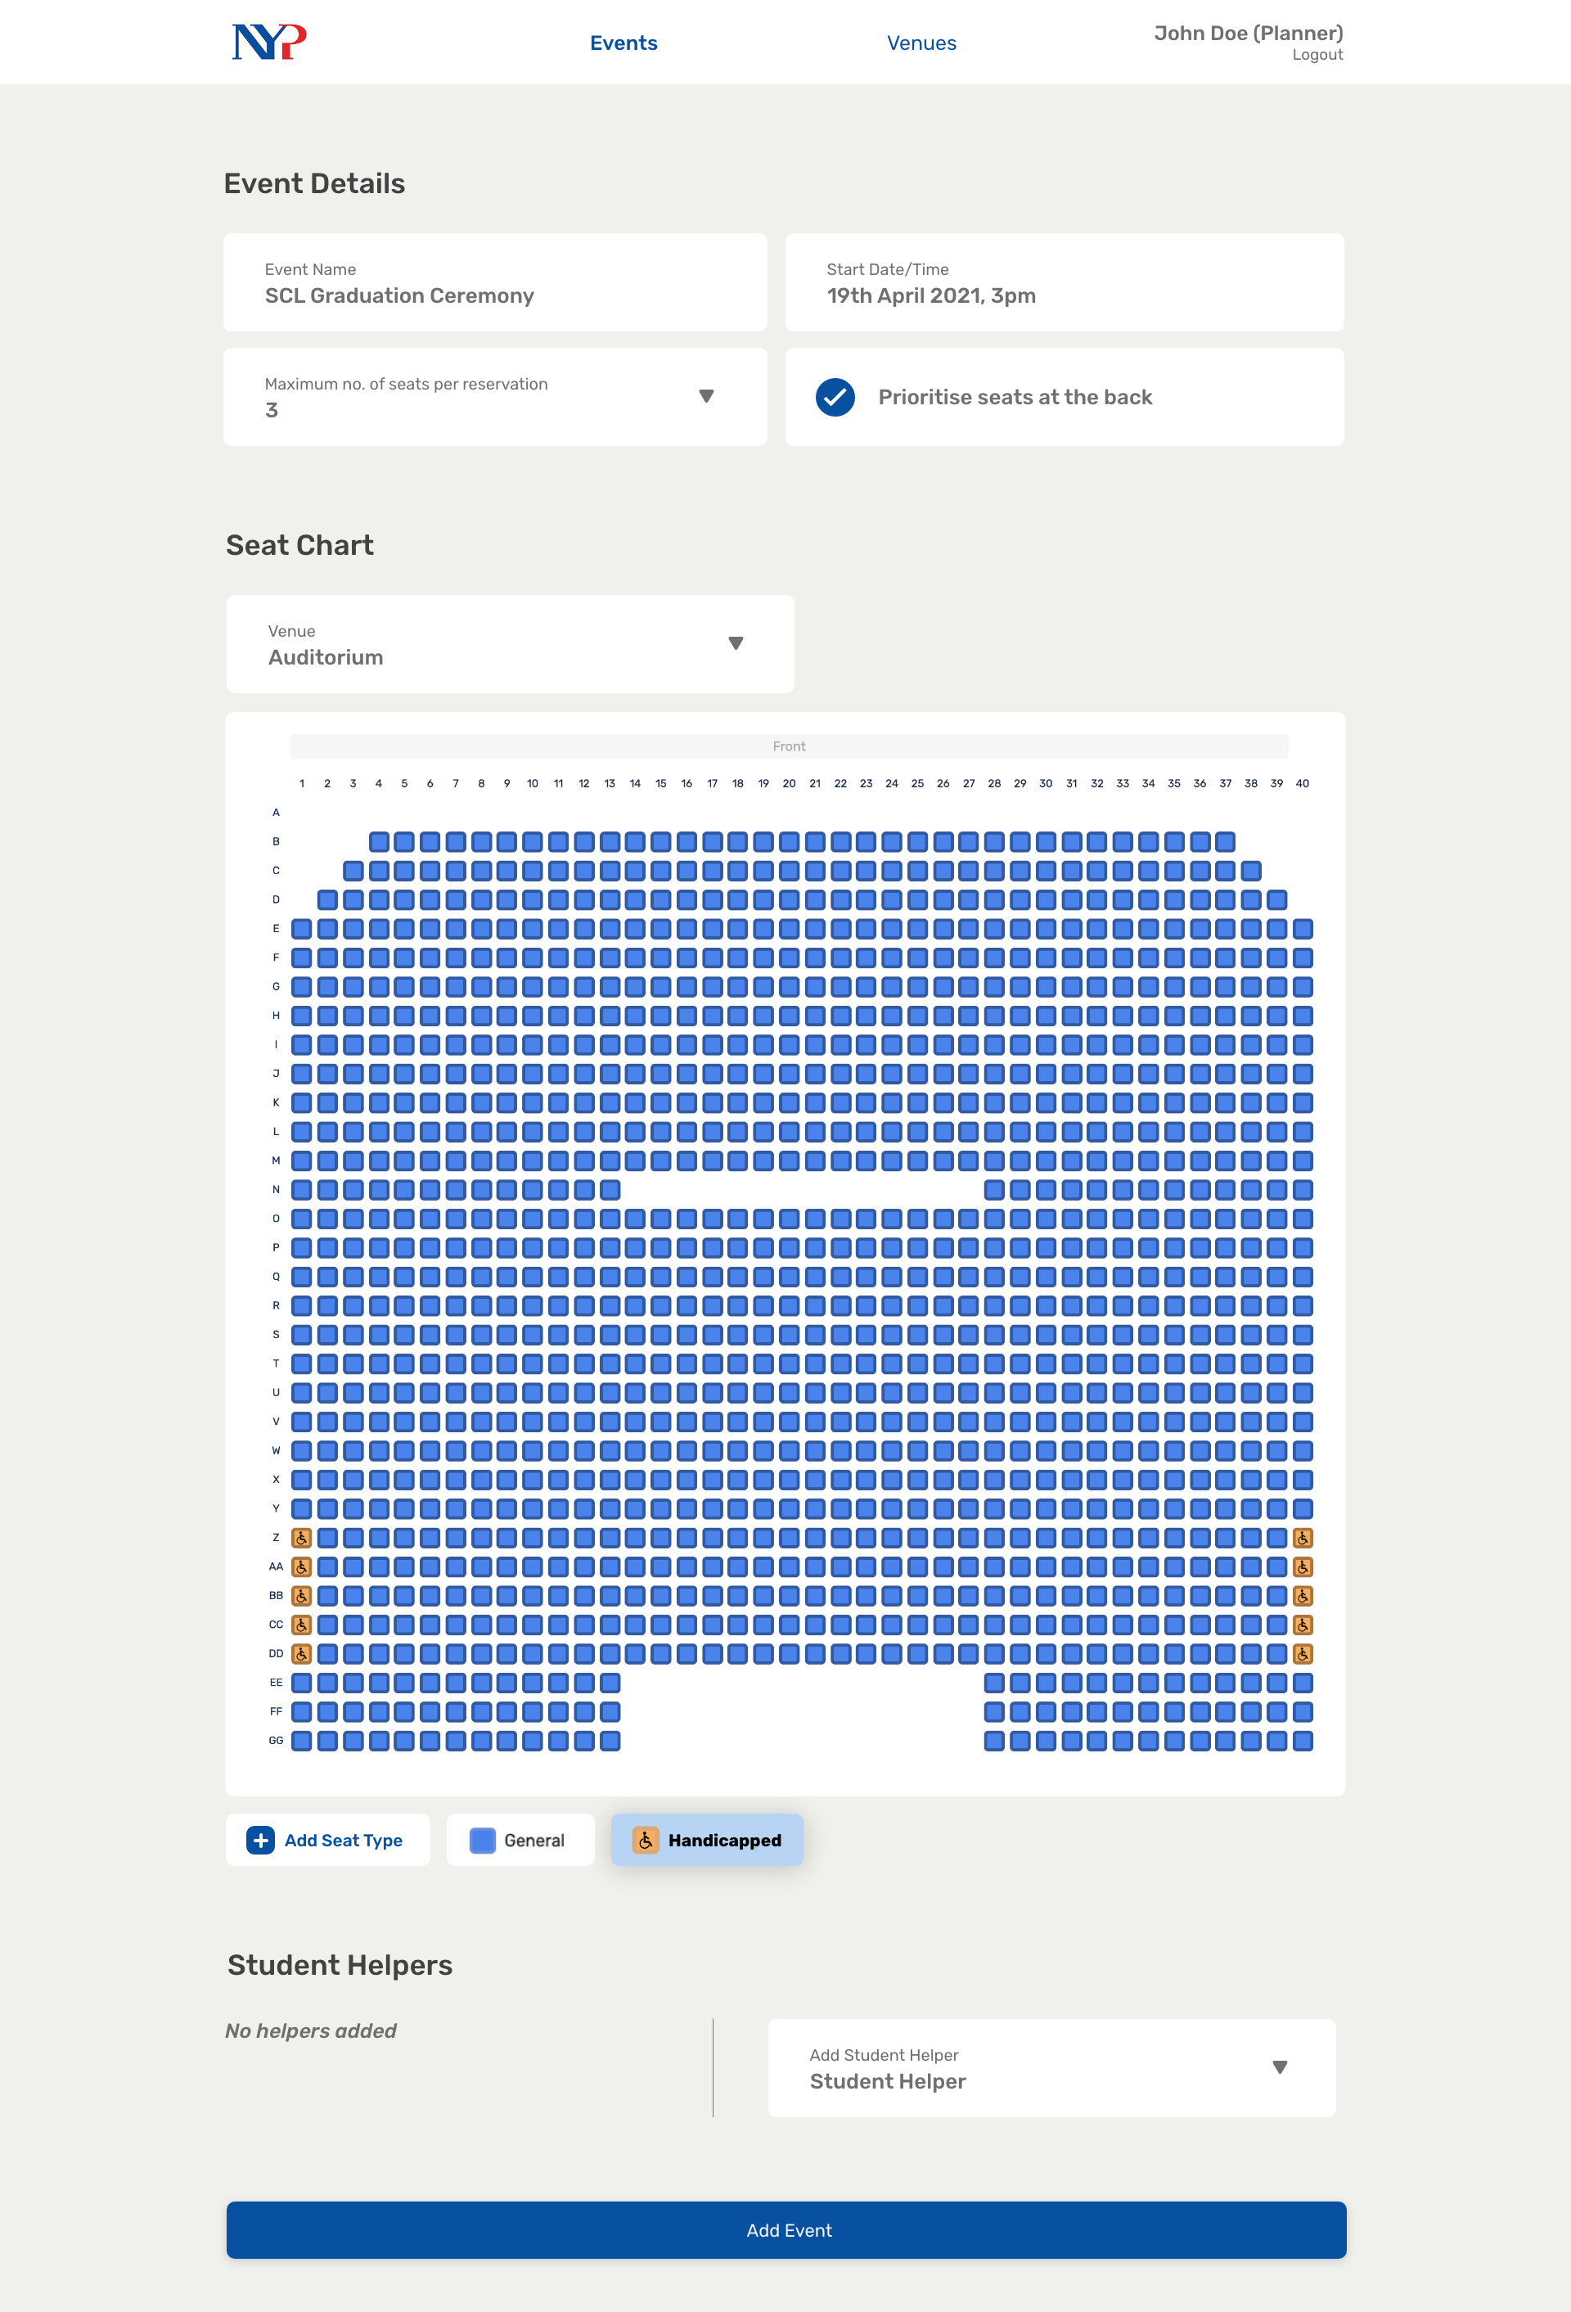
Notes:
36

Slide 41
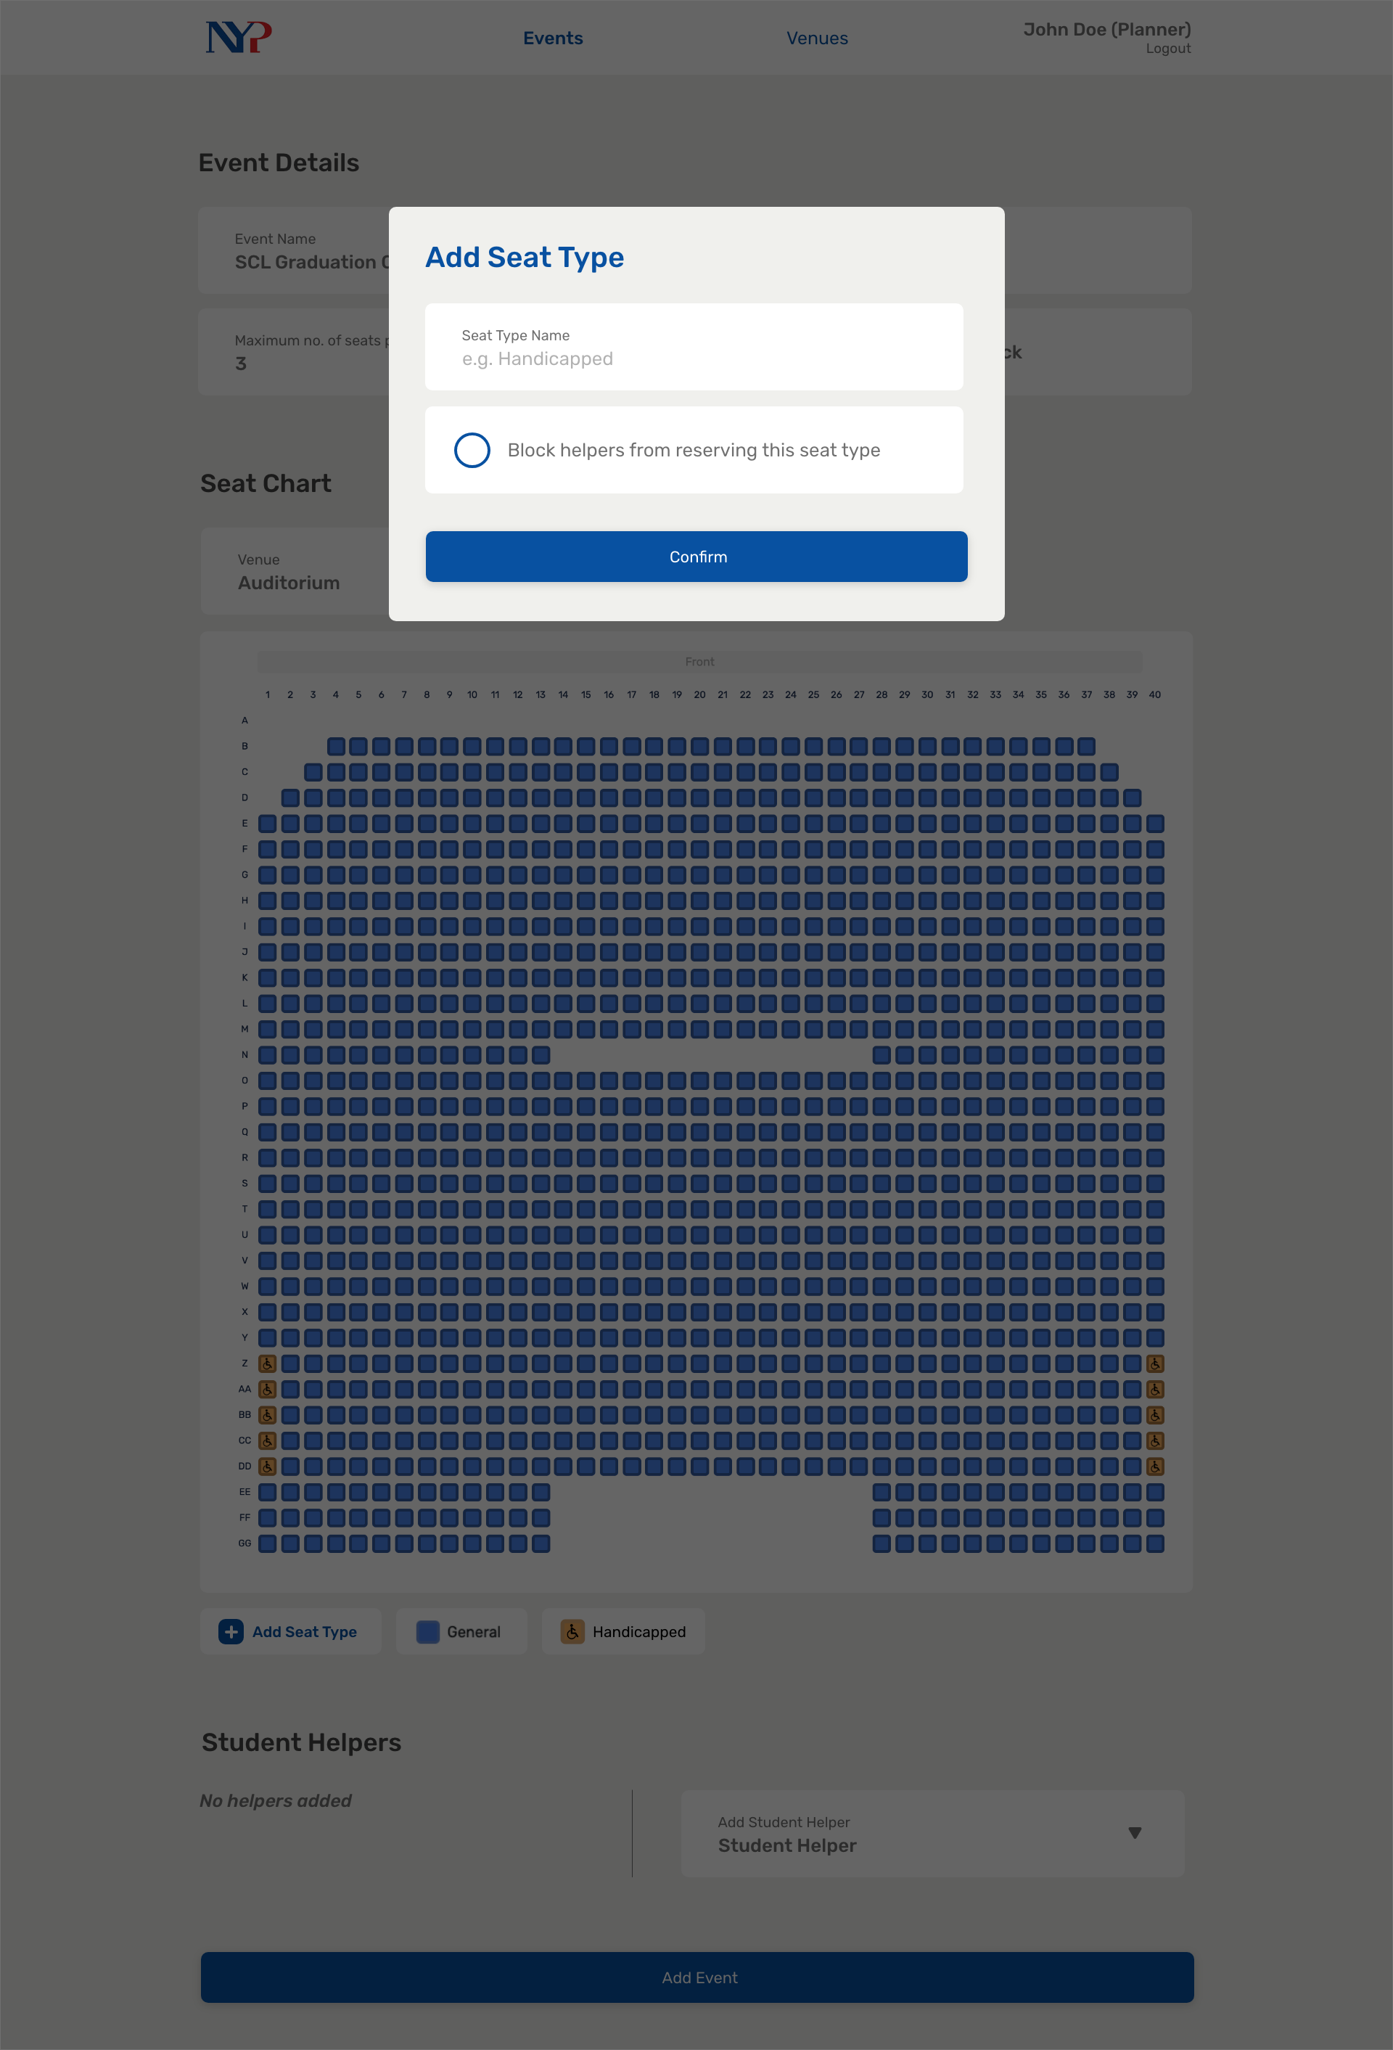
Notes:
37

Slide 42
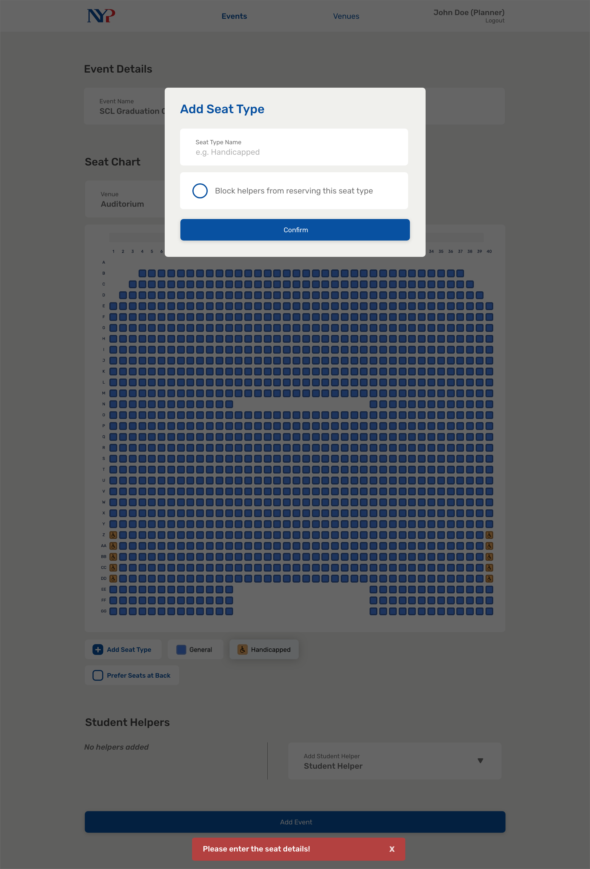
Notes:
38

Slide 43
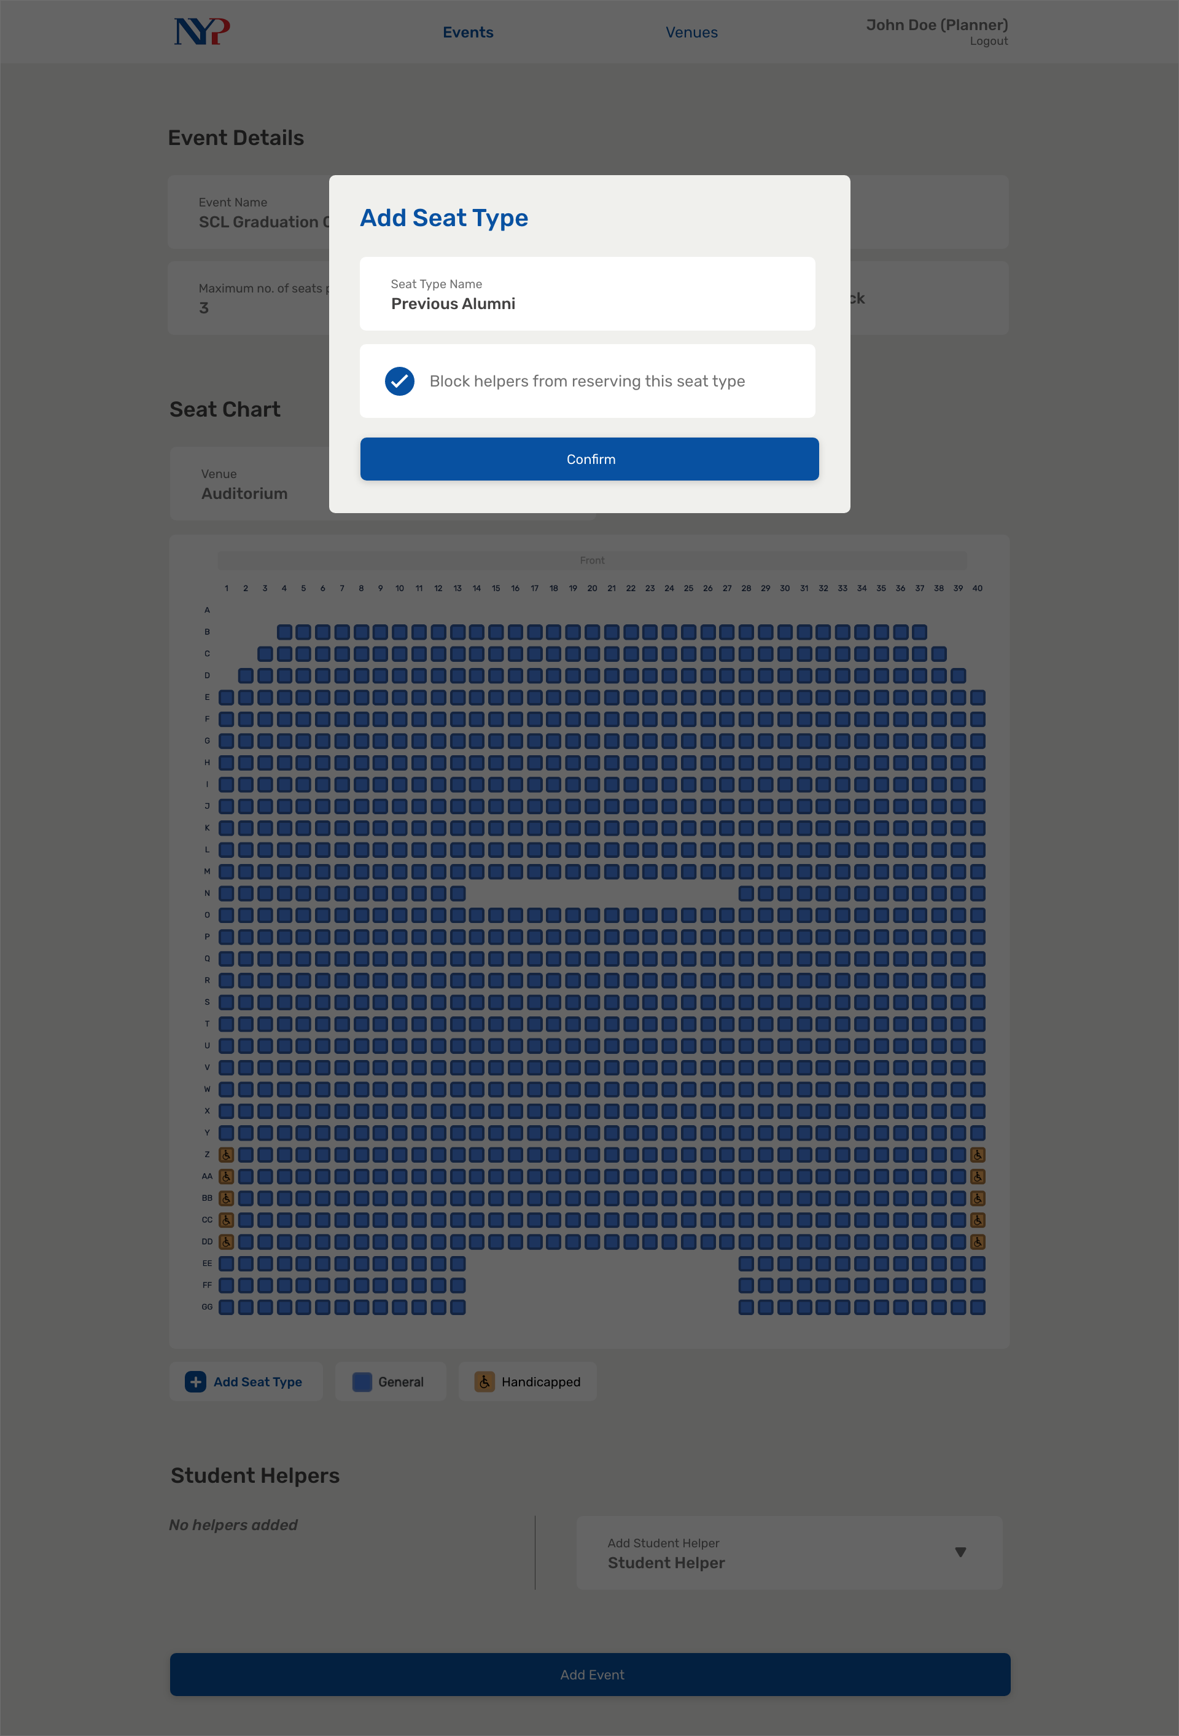
Notes:
39

Slide 44

Notes:
40

Slide 45
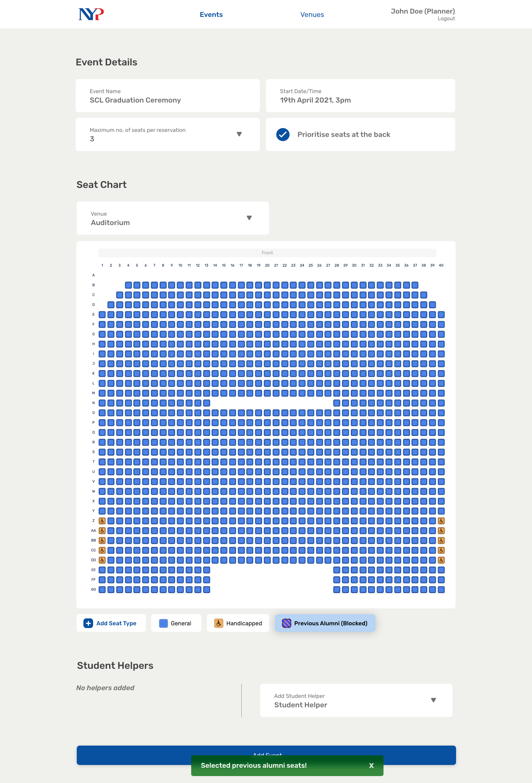
Notes:
41

Slide 46
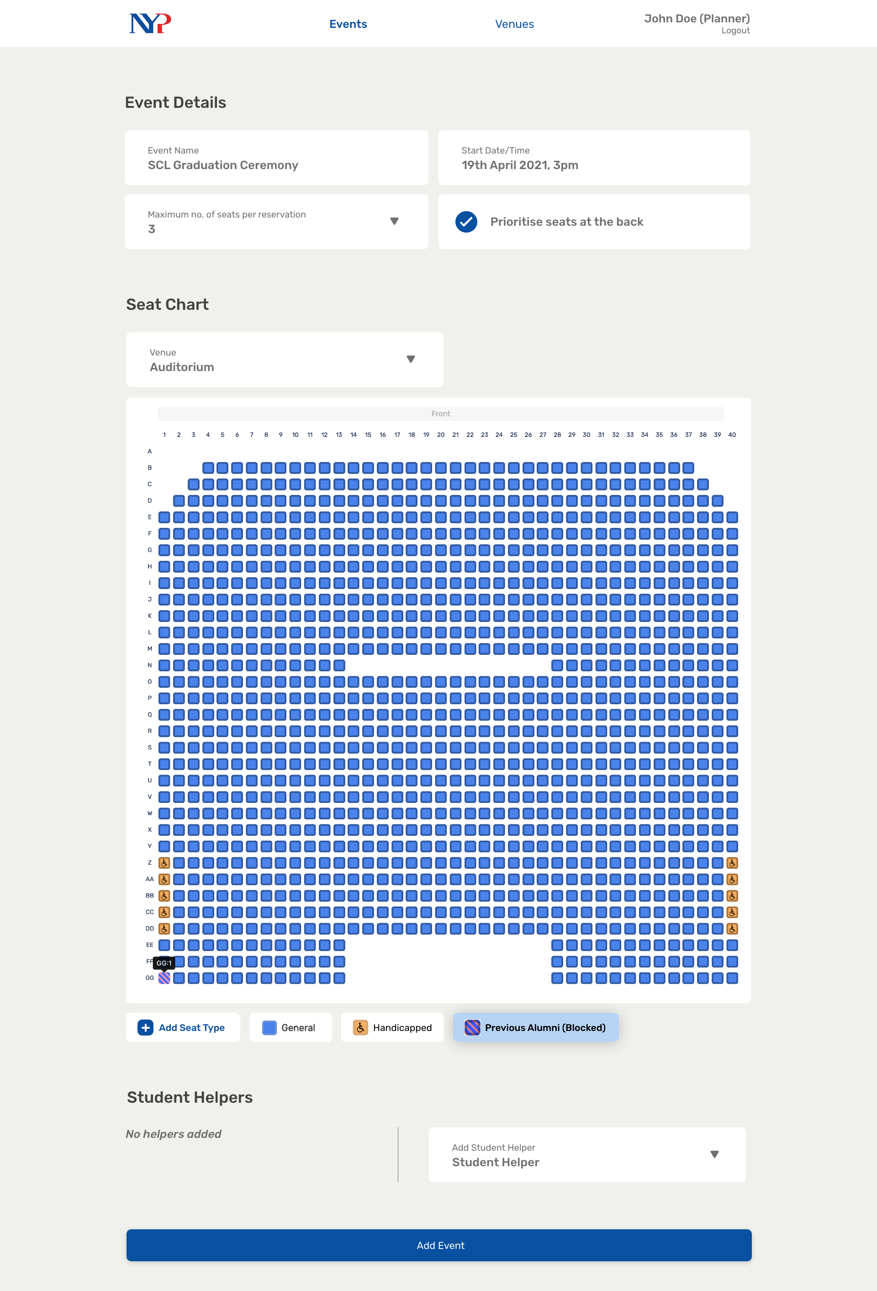
Notes:
41.5

Slide 47
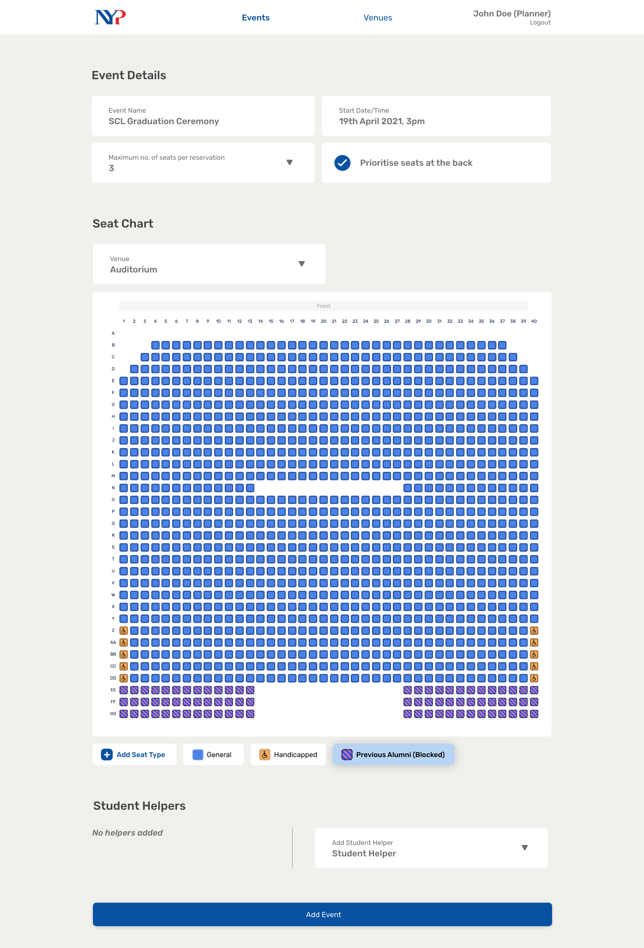
Notes:
42

Slide 48
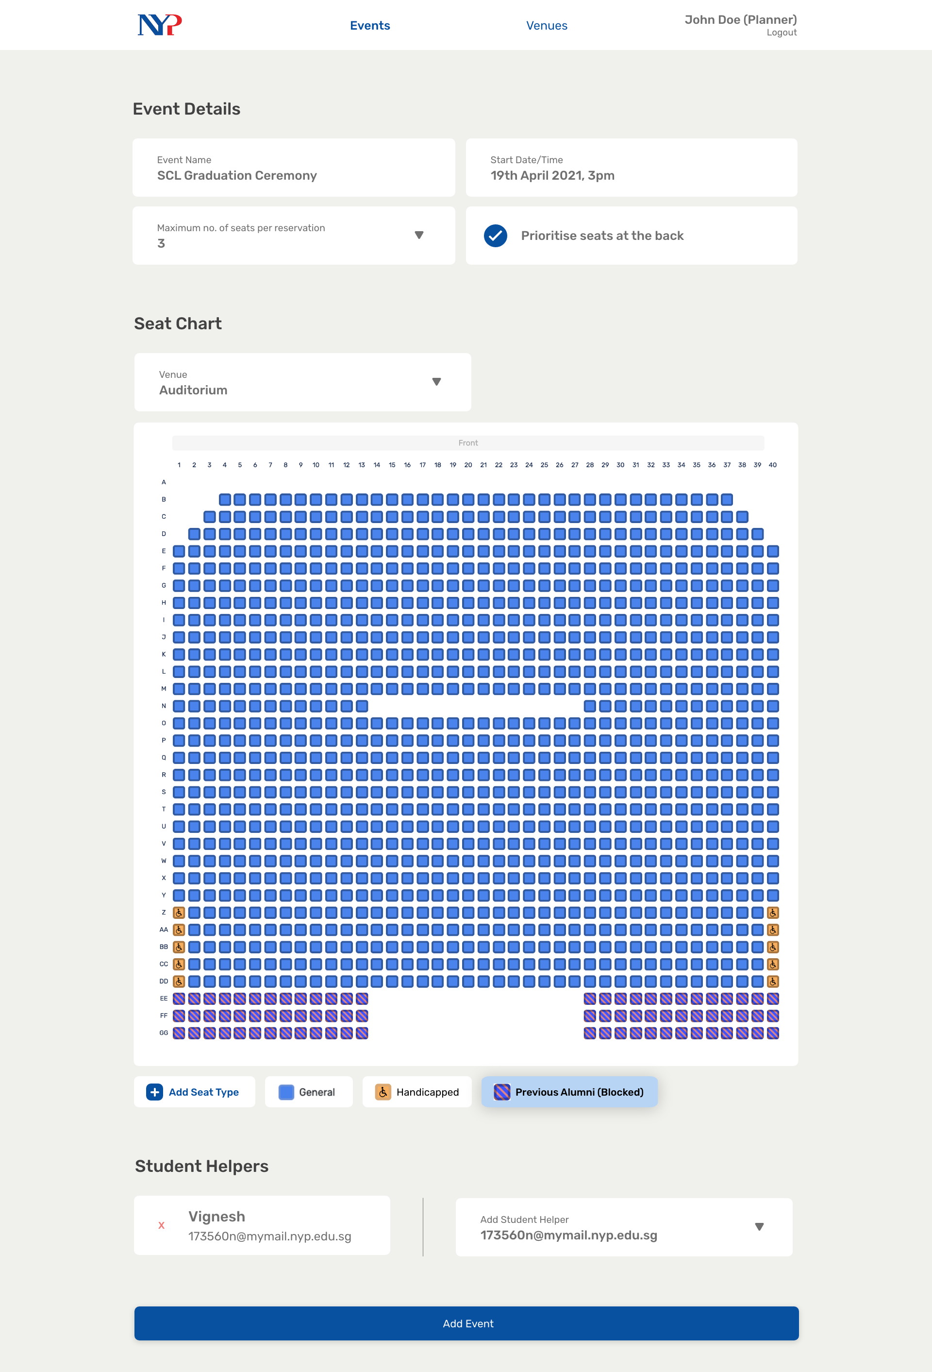
Notes:
43

Slide 49
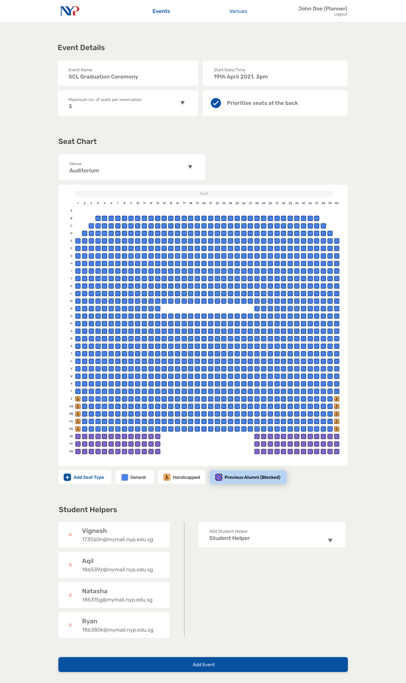
Notes:
43.5

Slide 50
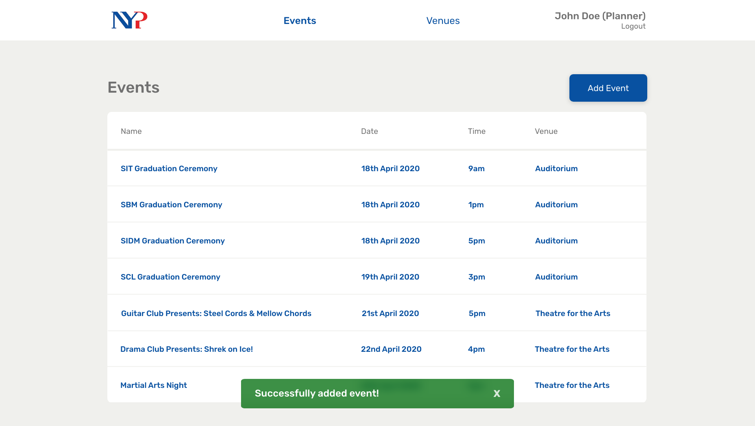
Notes:
44

Slide 51
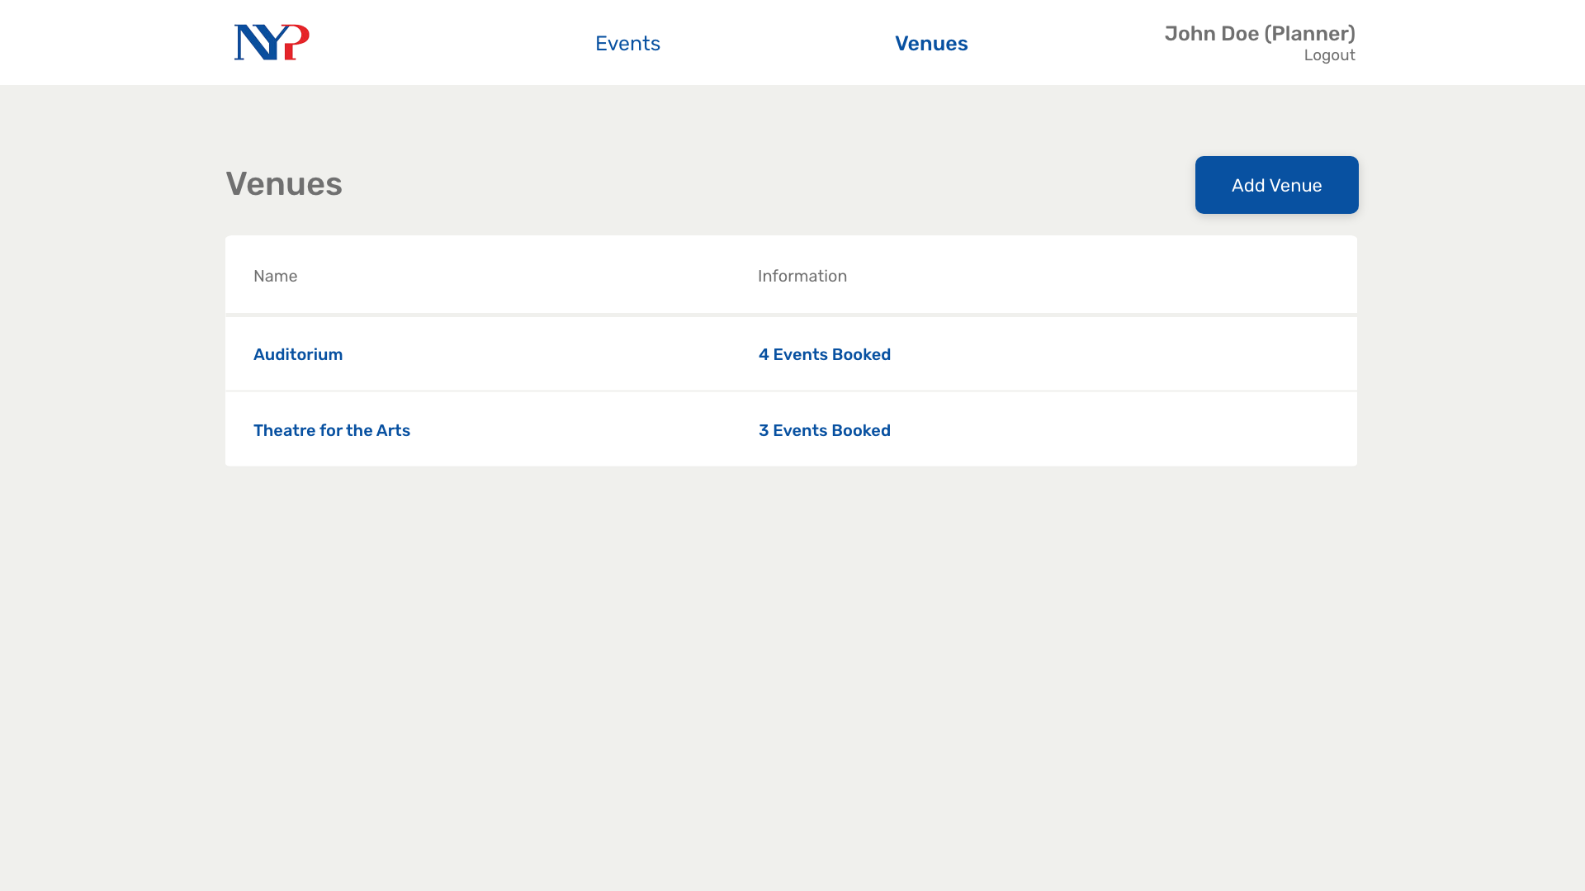
Notes:
46

Slide 52
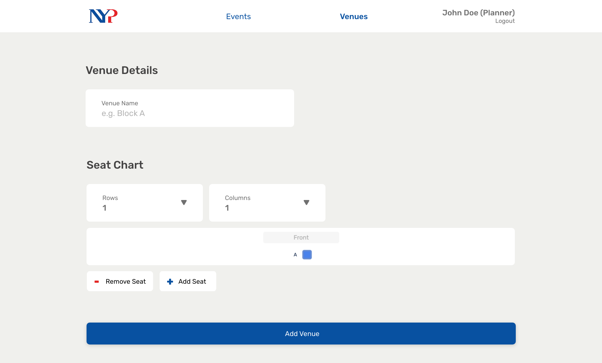
Notes:
47

Slide 53
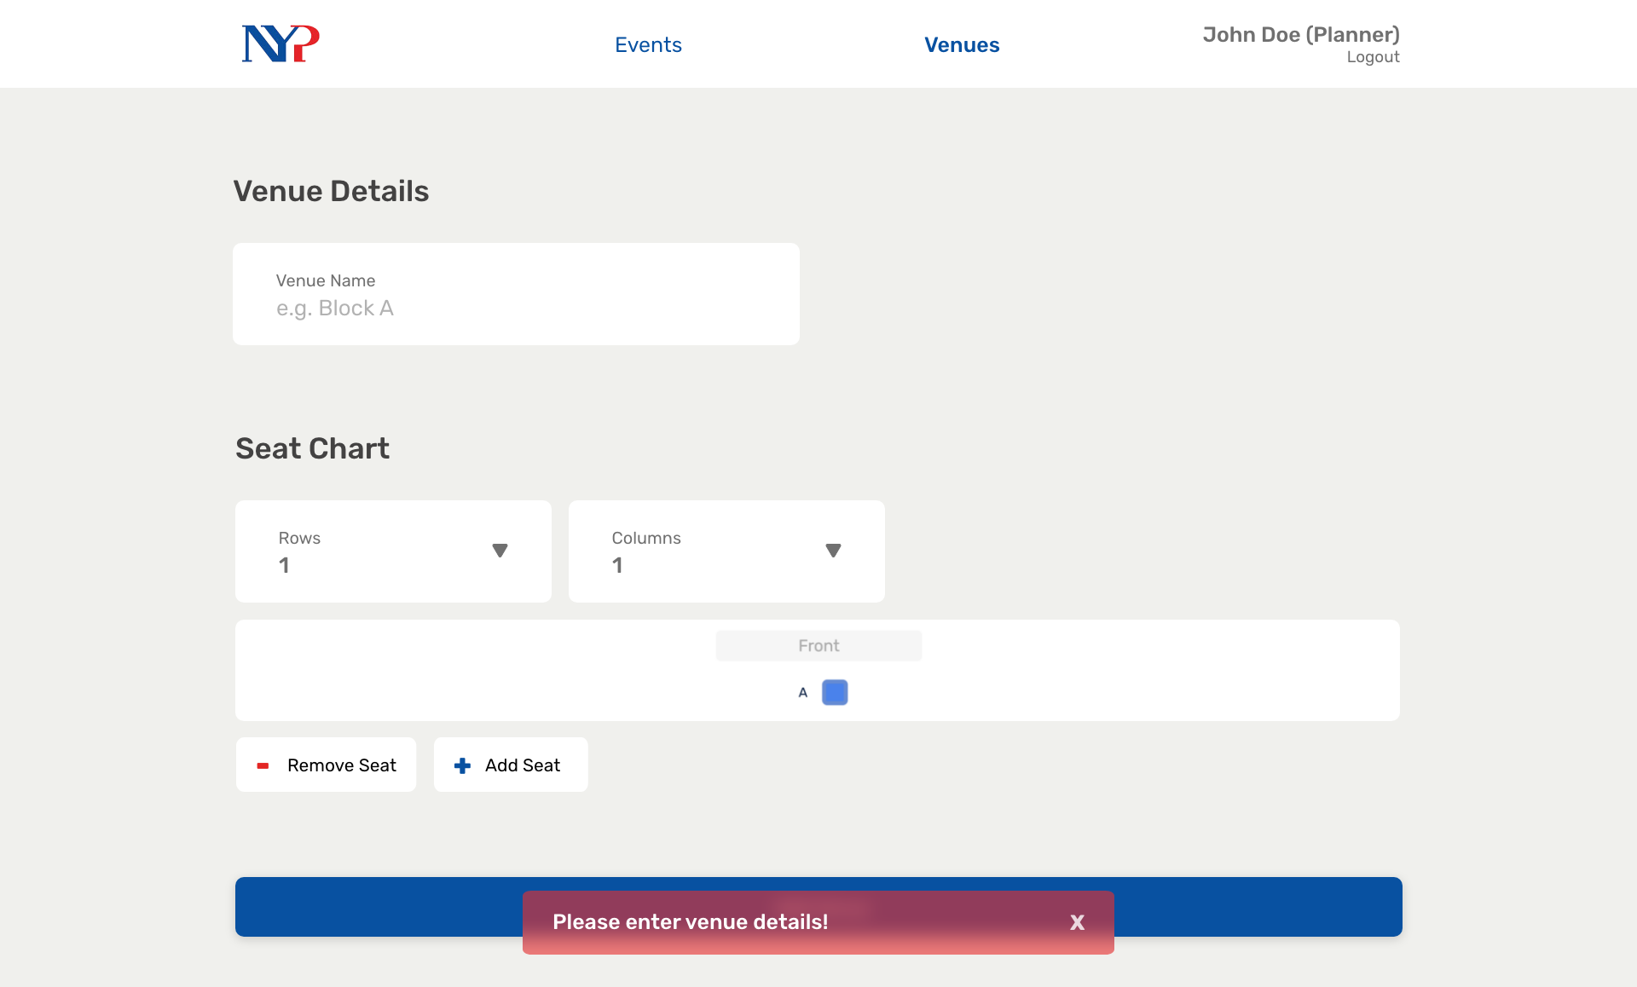
Notes:
48

Slide 54
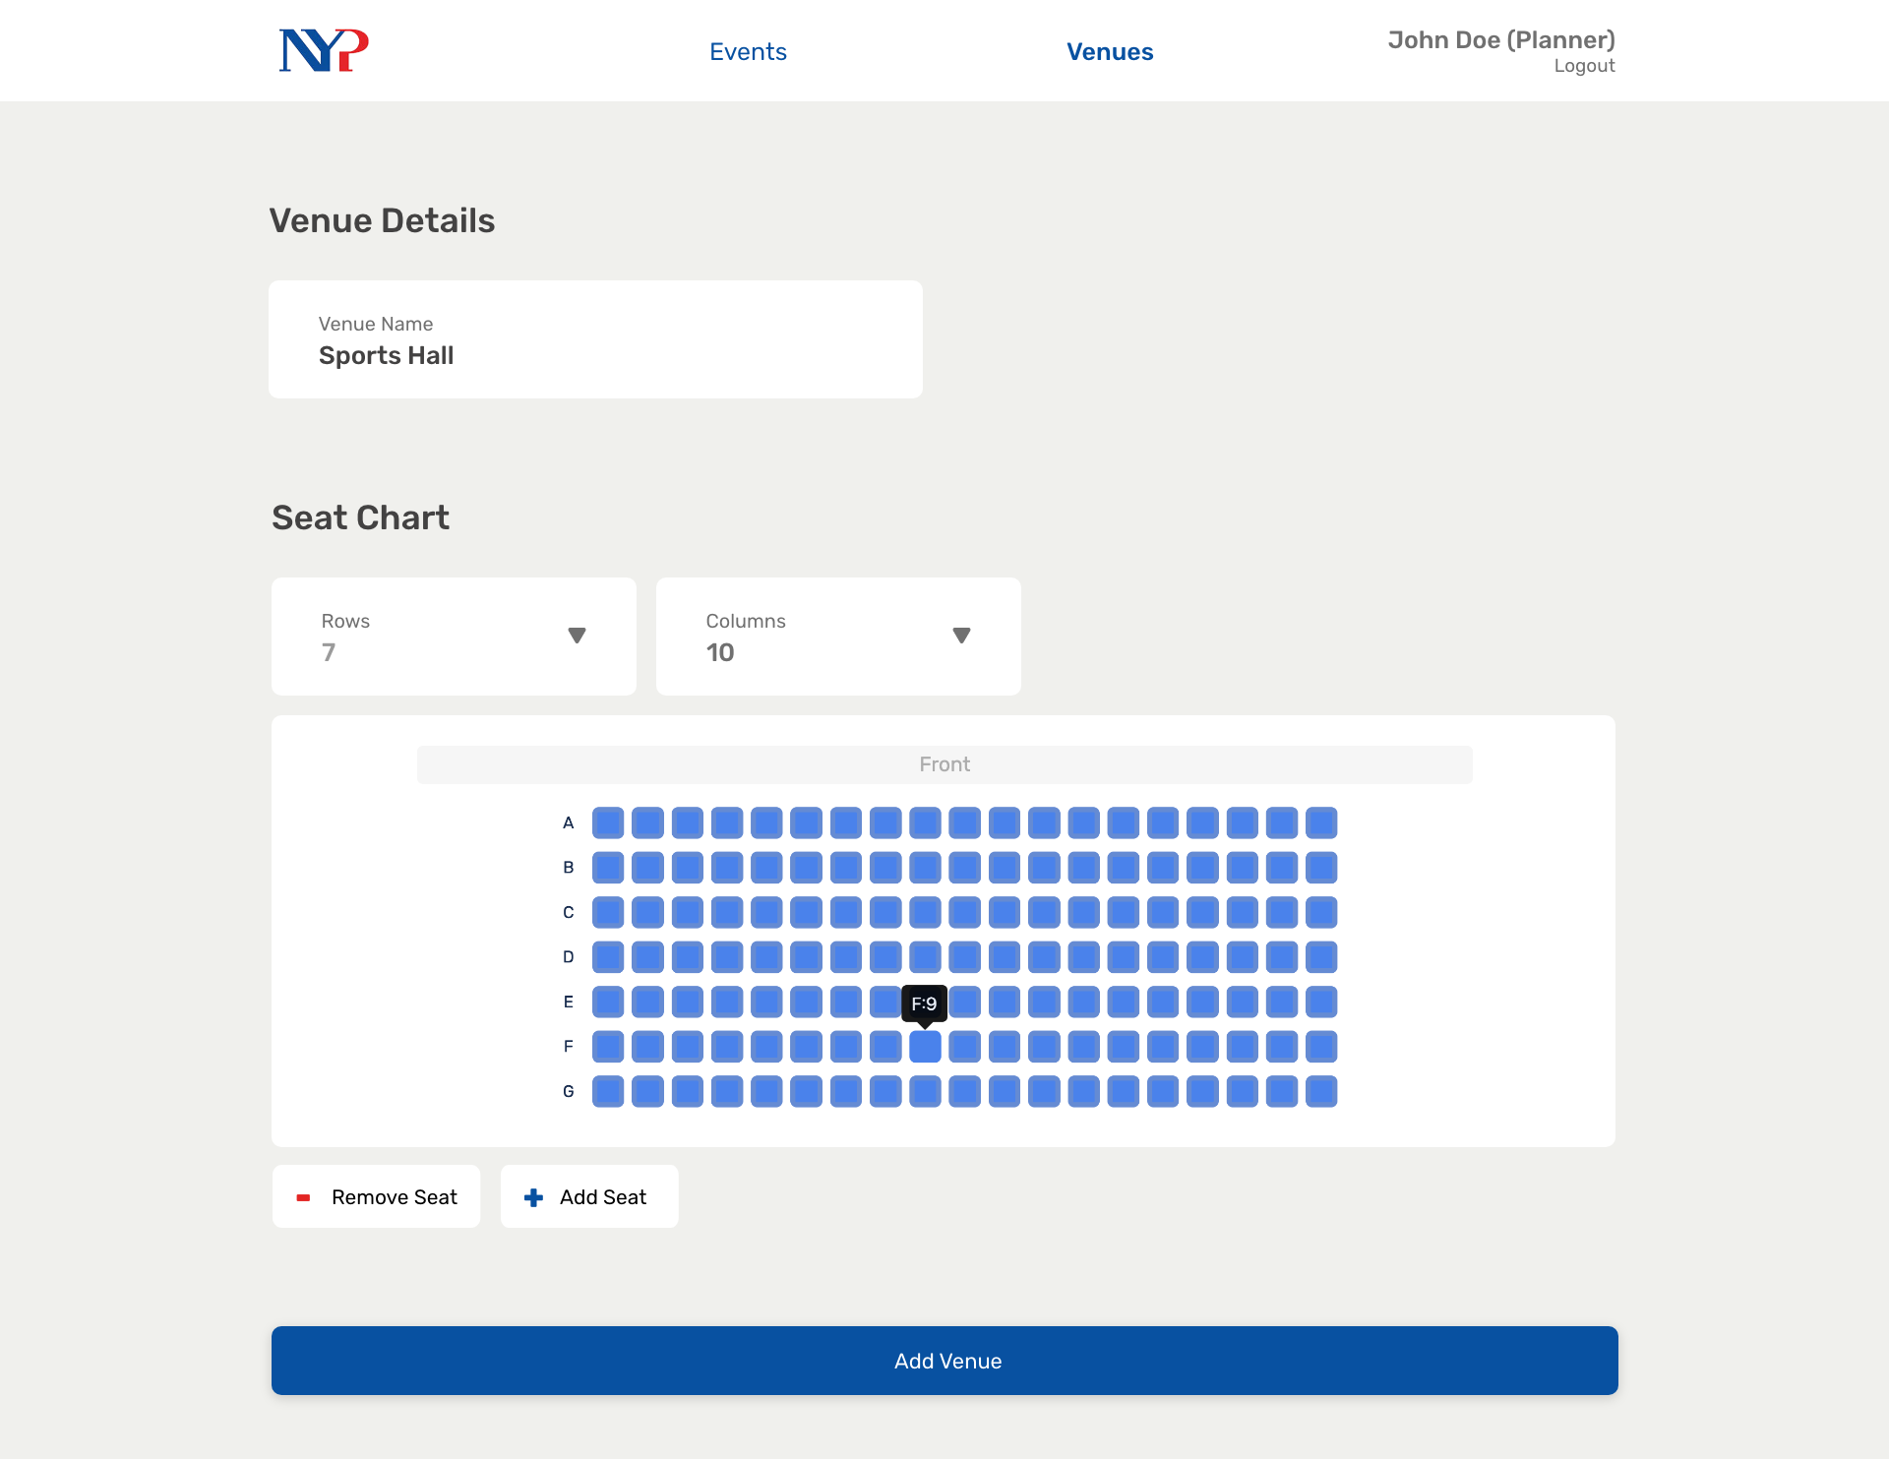
Notes:
49

Slide 55
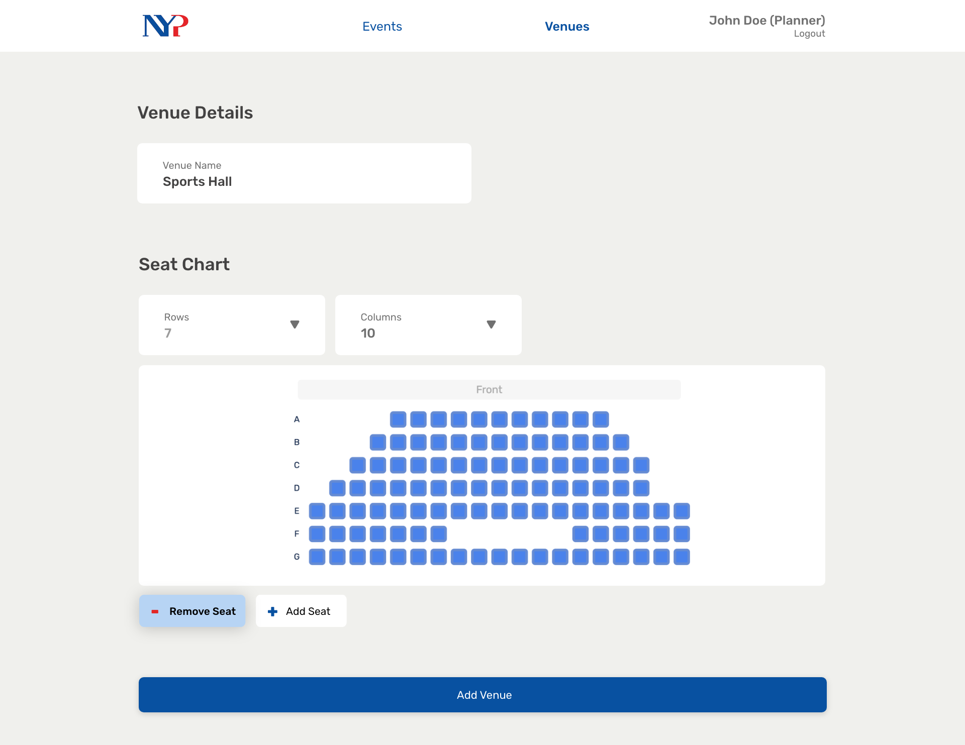
Notes:
50

Slide 56
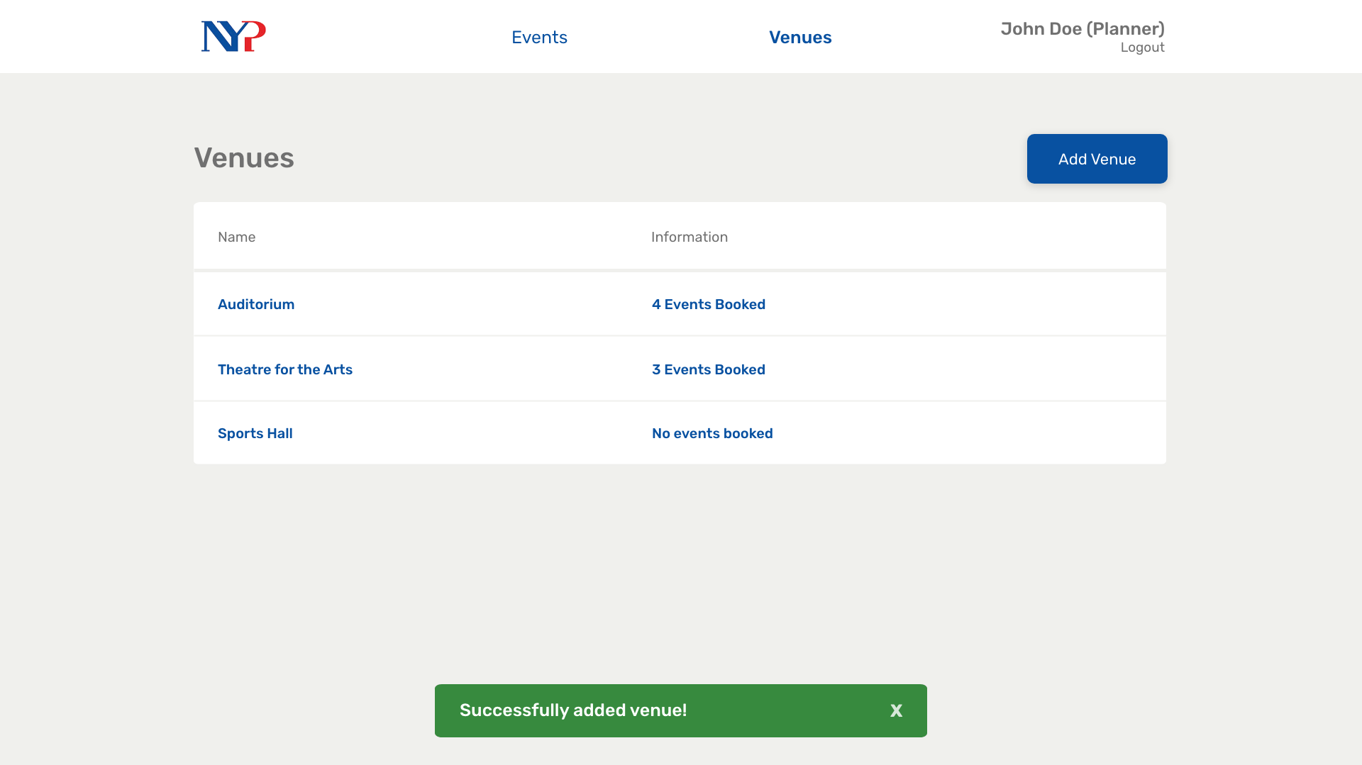
Notes:
51

Slide 57
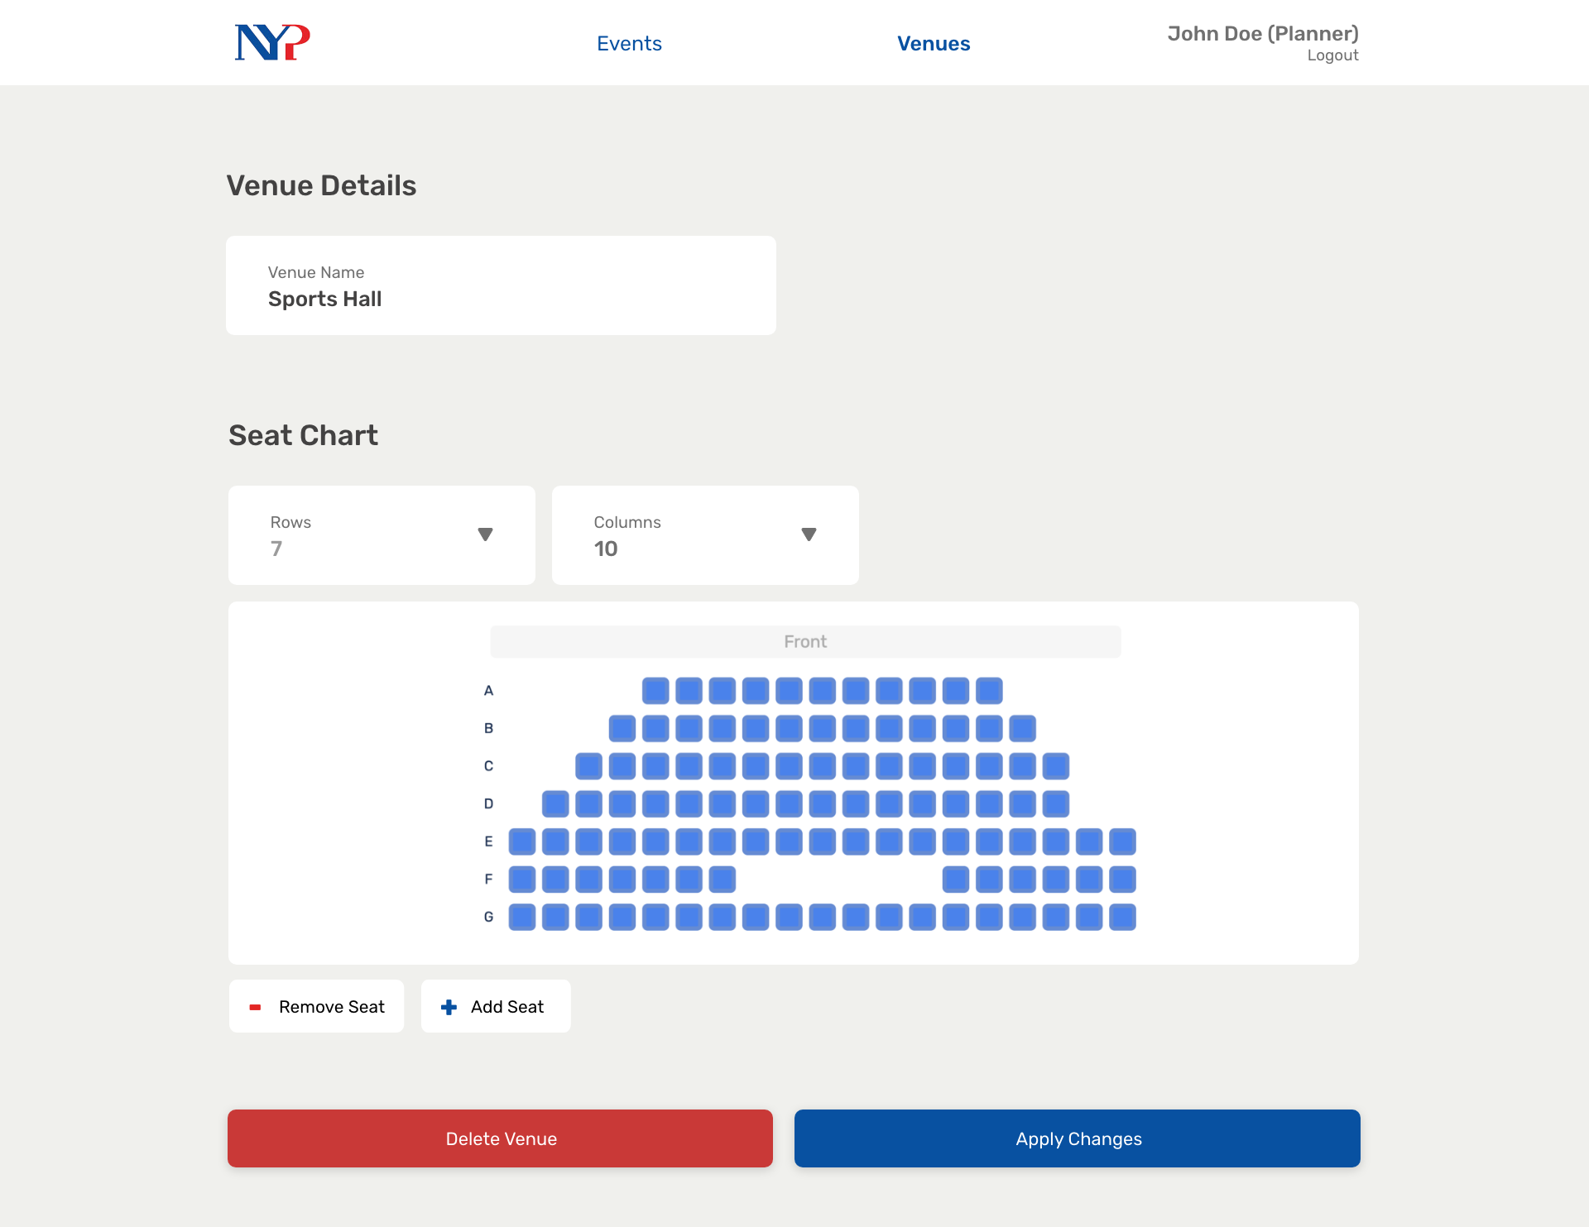
Notes:
52

Slide 58

Notes:
53 Admin

Slide 59
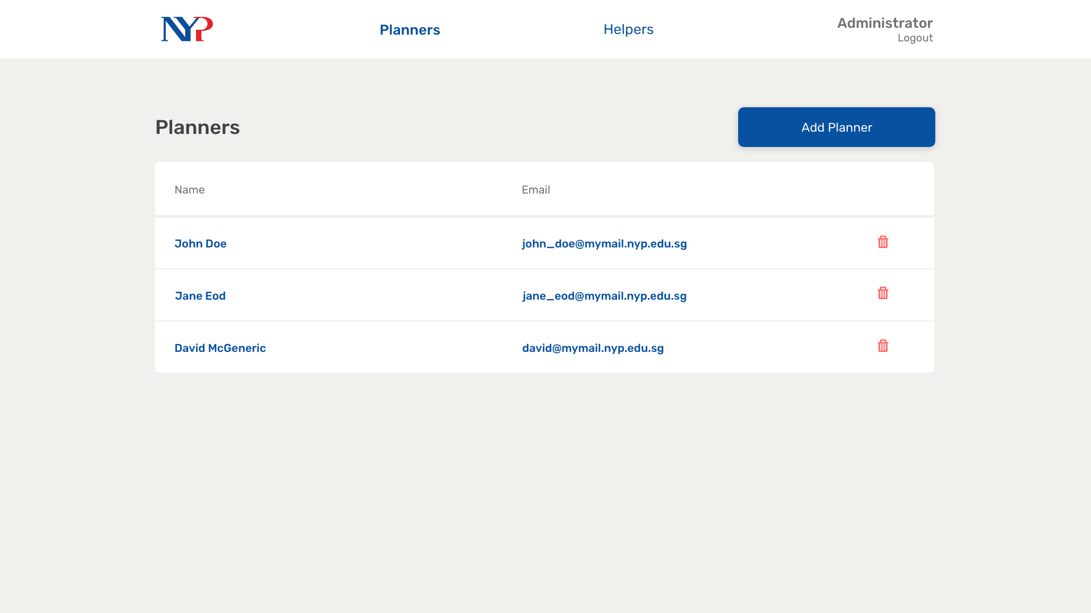
Notes:
54

Slide 60
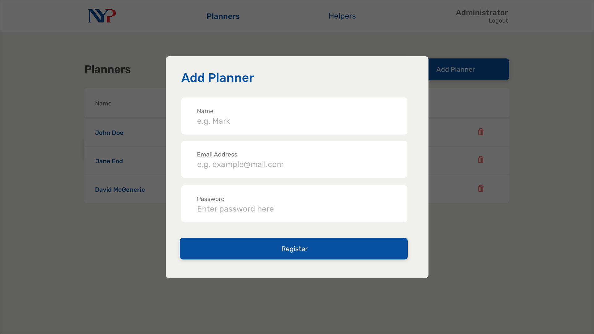
Notes:
55

Slide 61
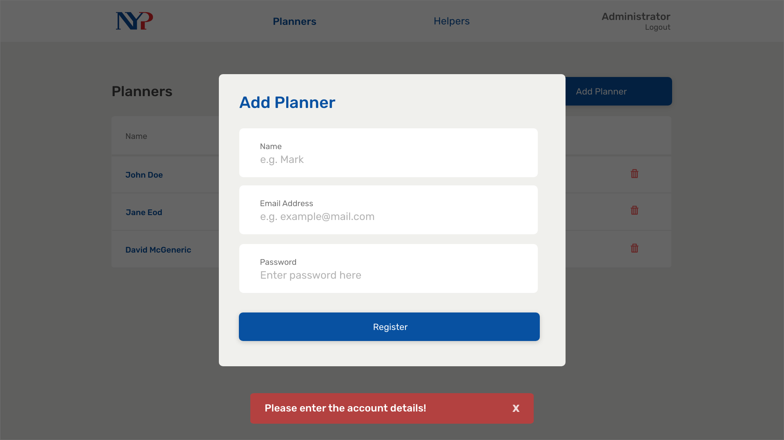
Notes:
56

Slide 62

Notes:
57

Slide 63
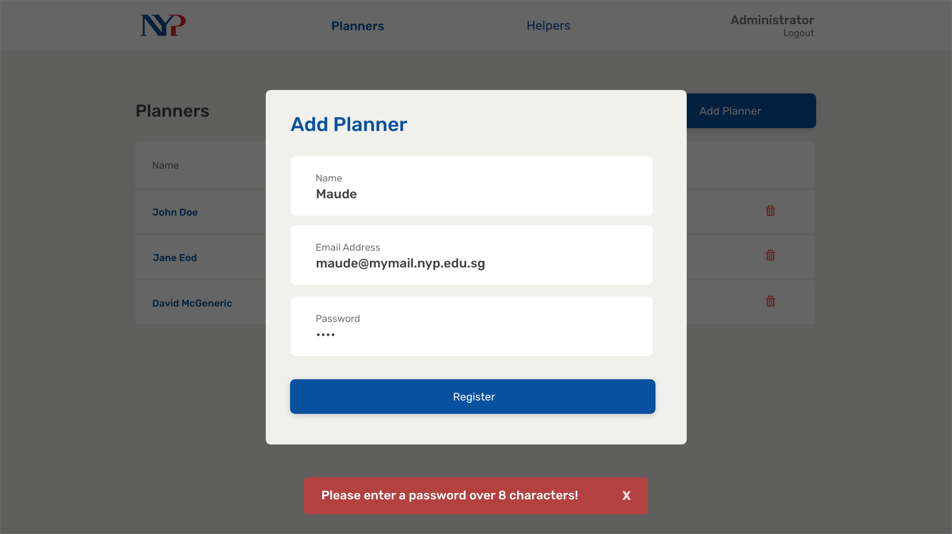
Notes:
58

Slide 64
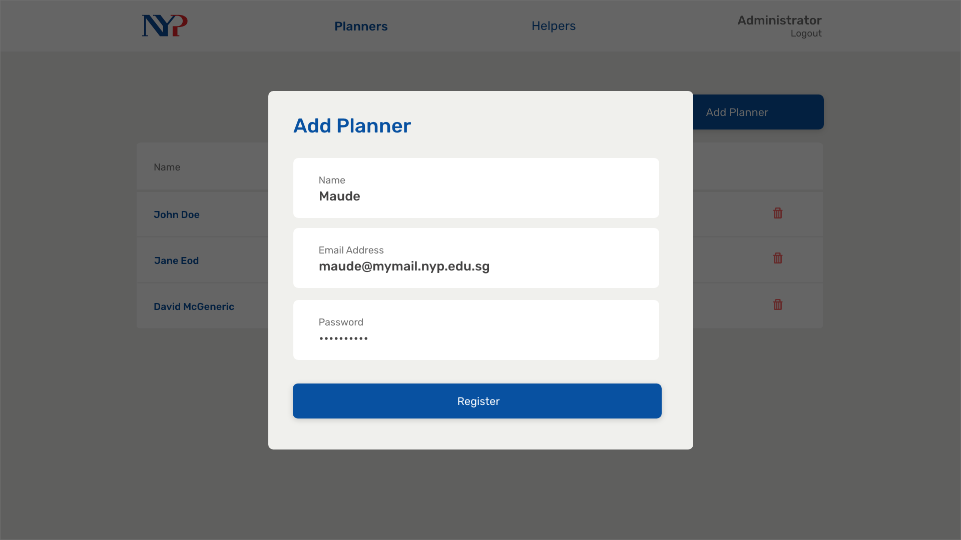
Notes:
59

Slide 65
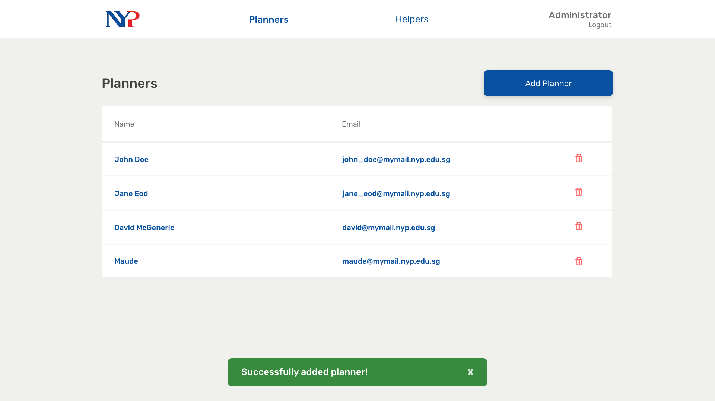
Notes:
60

Slide 66
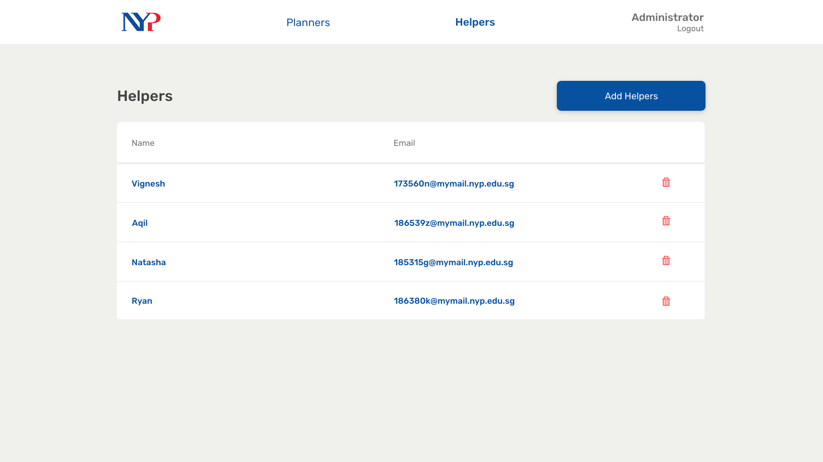
Notes:
61

Slide 67
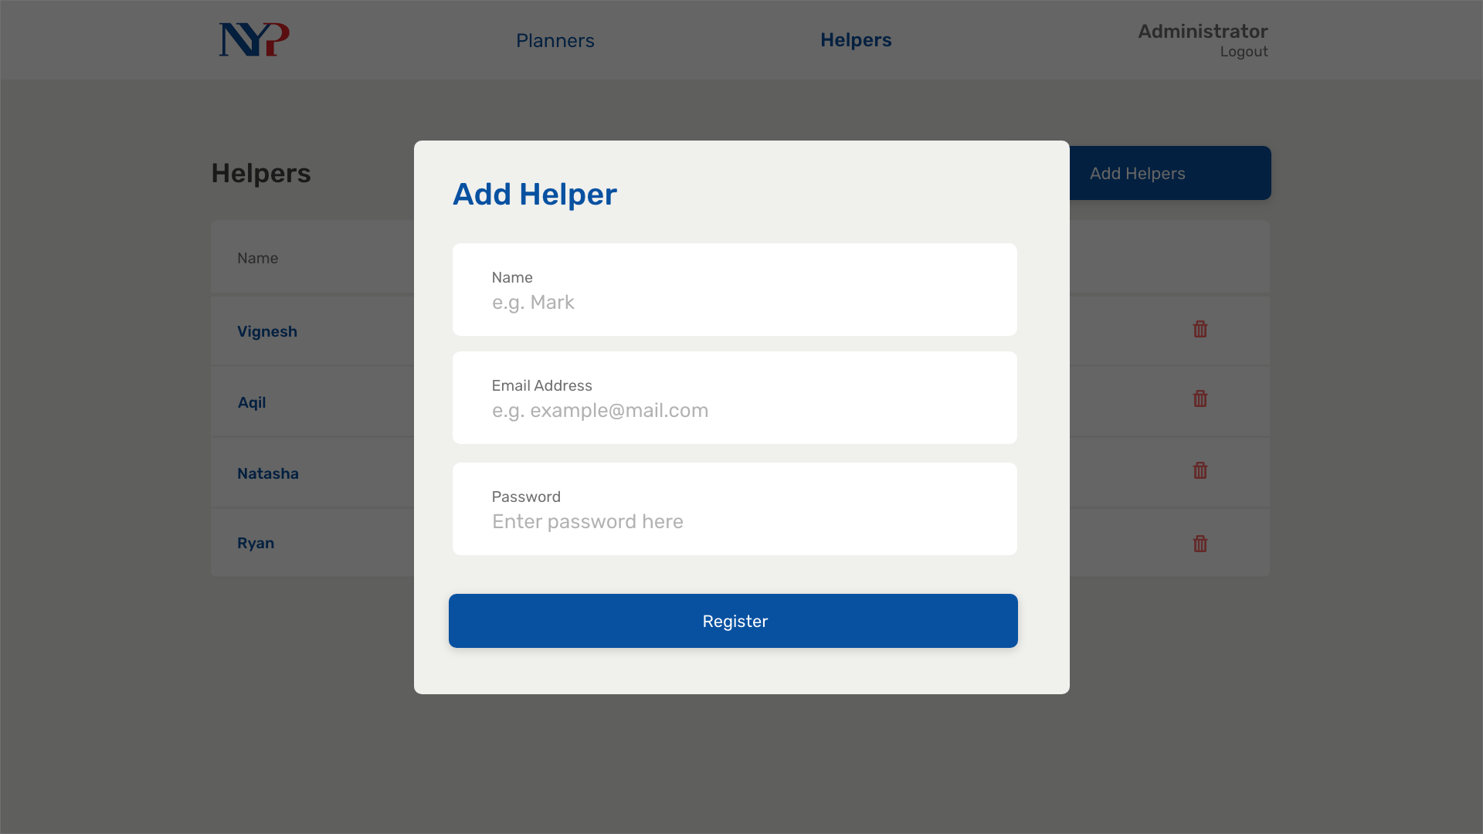
Notes:
62

Slide 68

Notes:
64

Slide 69
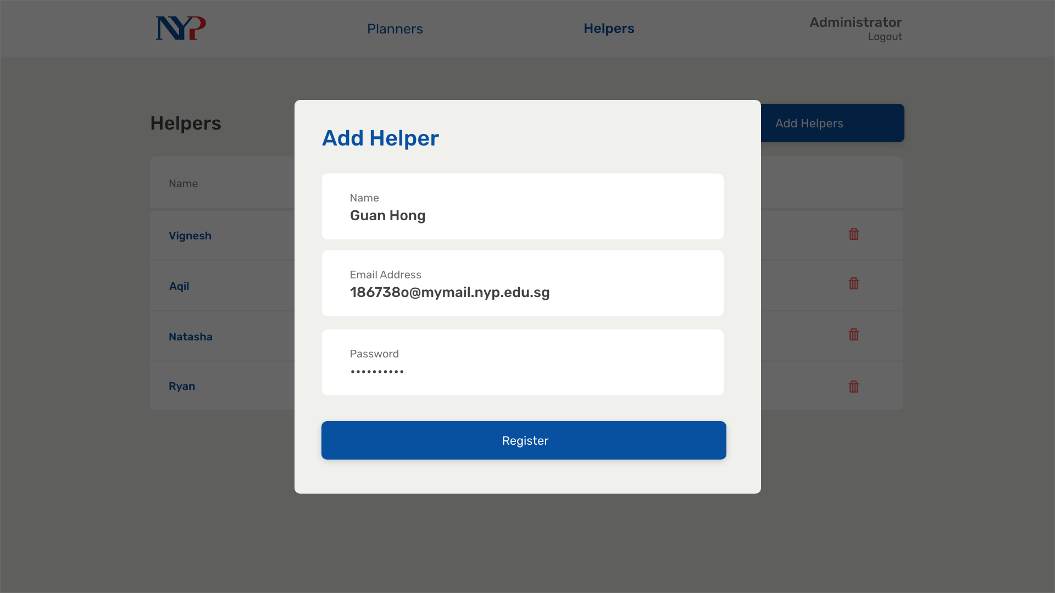
Notes:
63

